Slide 1
Theme activity:
The Eskdalemuir dB/dt anomalous return period
Assessing the dependence of extreme rates of change on magnetic-latitude
Phil Livermore (Leeds)
Neil Rogers, Jim Wild, Emma Eastoe (Lancaster)

Slide 2
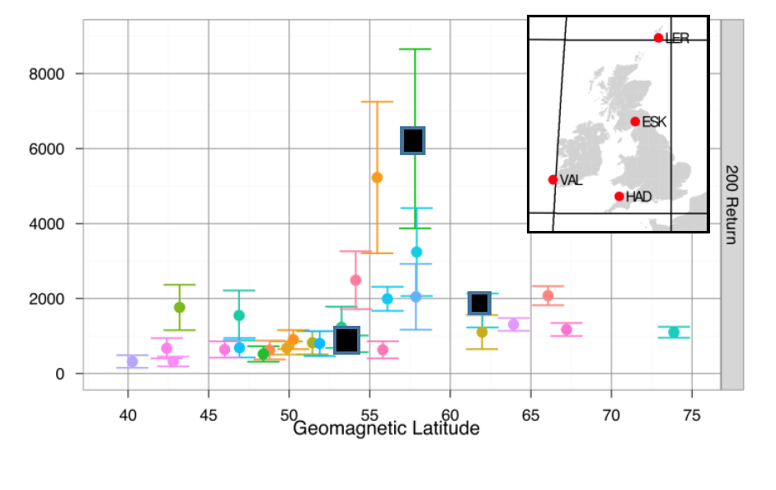
A plot from the proposal…200 year return period of extreme dH/dt fitted
to European observatories
Q. Is there a simple dependence of extreme values with magnetic latitude?
Q. Is the UK anomalous in terms of extreme values?

Slide 3
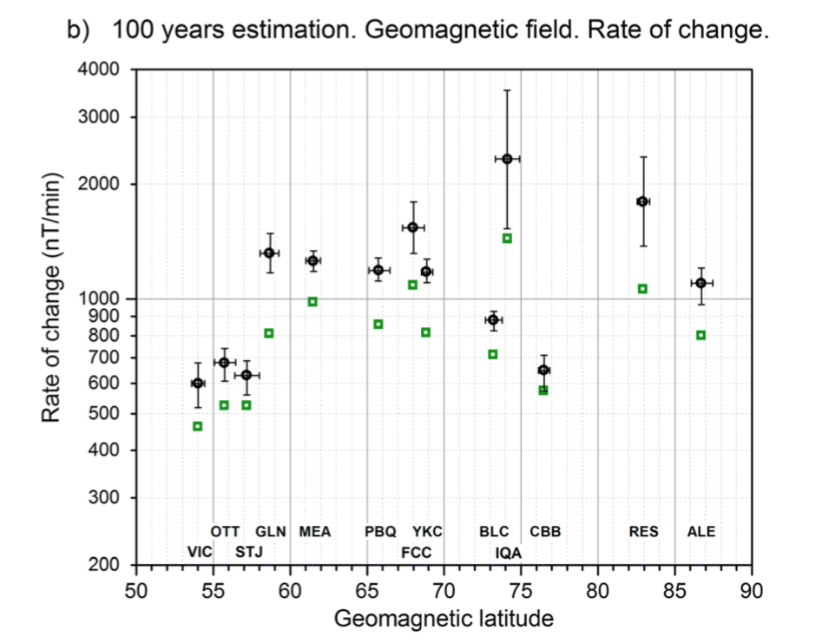
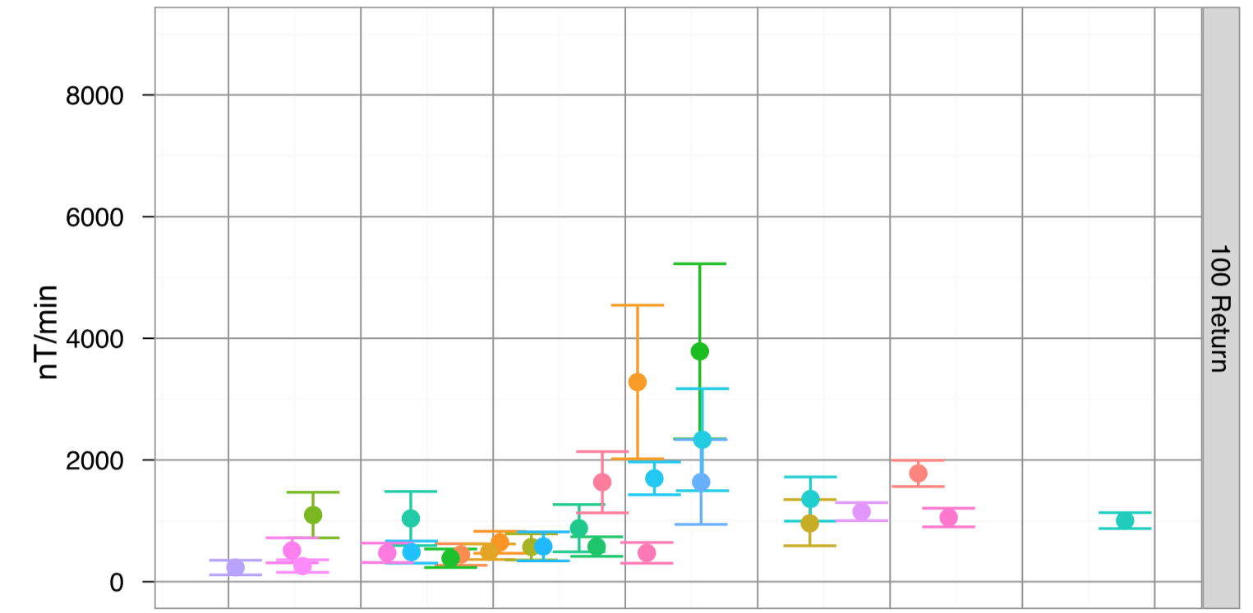
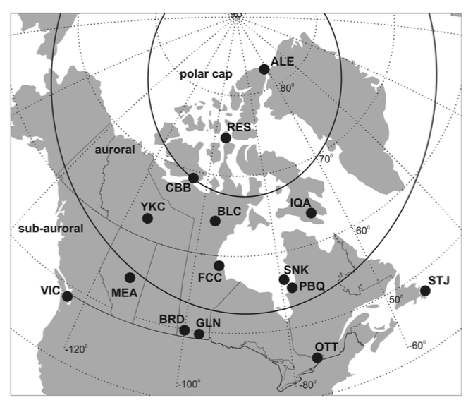
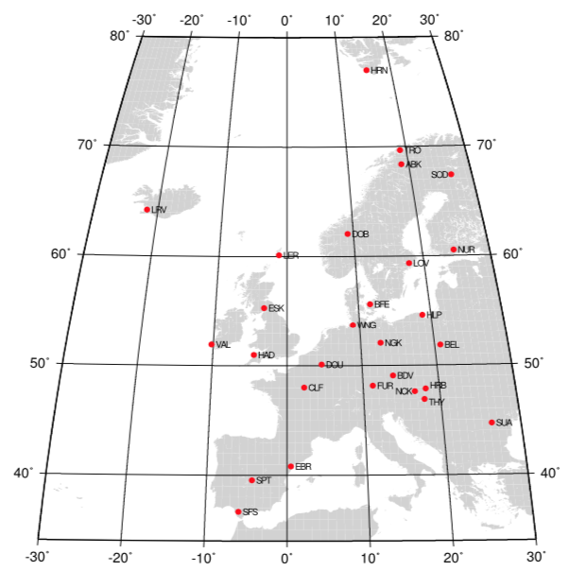
Thomson et al. (2011)
Nikitina et al. (2016)

Slide 4
Rationale
Issues:
1. Observatories have different time spans
(and so different amounts of data, some may have more extreme values than others)
2. How do we interpret different extreme values at observatories at the same latitude?
Perhaps they can both be explained by the same distribution.
3. Just how anomalous is ESK?
Rationale: extend the European and Canadian studies to a worldwide dataset
Although estimates have been made of the uncertainty at each observatory,
what is the simplest description in latitude that fits everything adequately?
(e.g. a distribution independent of latitude)?

Slide 5
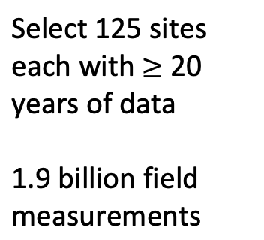
SuperMAG magnetometer data
Select 125 sites each with 20 years of data
1.9 billion field measurements

Slide 6


Large $\left|dB_{H}/dt\right|$ (99.97 percentiles)
http://supermag.jhuapl.edu/
Contours show corrected geomagnetic latitudes (from IGRF Epoch 2000).
Notes:
Note the increase in |dB/dt| at 60-75° geomagnetic (North and South).
BRW (Barrow) is the outlier in Northern Alaska.

Slide 7

Percentiles of $\left|dB_{H}/dt\right|$
Notes:
The outlier at ~71°(N) is Barrow (BRW), Alaska. Data from BRW contained large field fluctuations, but it was not obvious whether these were artificial.

Slide 8
Extreme Value Theory
Under modest assumptions, extreme values of any distribution can be modelled by a generalised Pareto Distribution (GPD)
For known parameters, we can compute any diagnostic (e.g. 200-yr return values)
Aim: given a dataset, find the parameters
Here, we allow the shape/scale parameters to depend on latitude
Practically, this is an exercise in parameter fitting given a limited dataset.
Need to quantify the uncertainty.

Slide 9
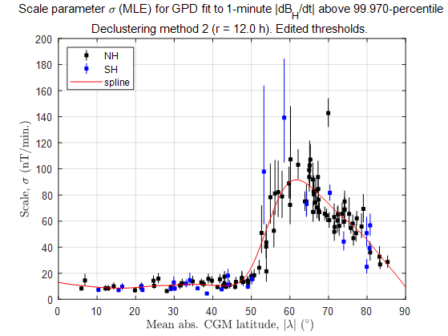
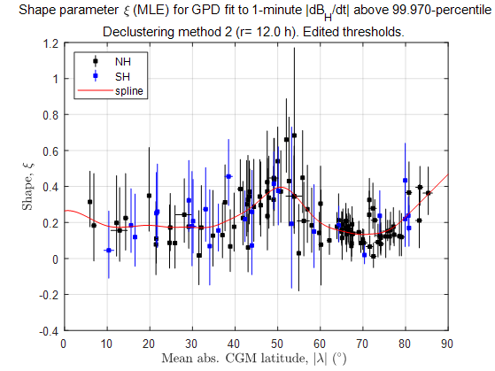



Maximum likelihood fits at each observatory
Scale parameter, $\tilde{σ}$
Shape parameter,
Can we do better than a spline fit (red line), and what might be its uncertainty?
Are uncertainties in scale/shape independent? i.e. can the dataset be explained by small uncertainties one parameter but larger uncertainties in the other?
$$Δt=1 minute$$
Decluster method 3: 12-h min. separation.
Threshold = 99.97th percentile

Slide 10
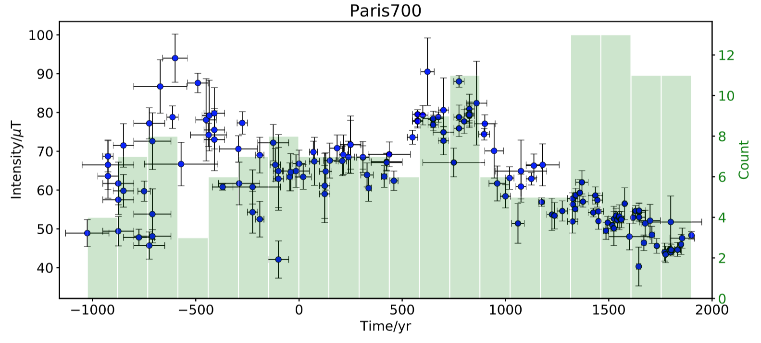
Transdimensional Bayesian inversion:
Drawing a curve through an incomplete dataset:
what is the smoothest model of posterior probability (i.e. of the model given the data)
and its uncertainty?
Livermore et al. (2018)

Slide 11
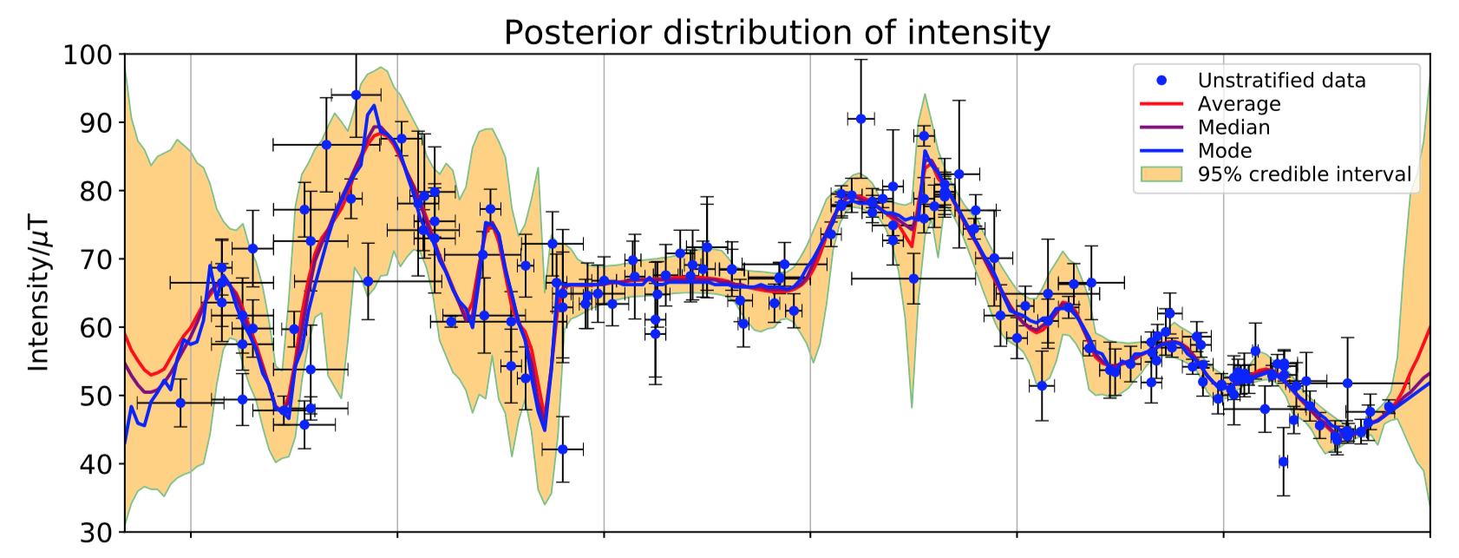
Transdimensional Bayesian inversion:
Livermore et al. (2018)
Assumptions:
Each ensemble member is piecewise linear (“minimal” complexity)
Average over ensemble (~ 1M models) gives smooth variation
Reasonable uniform priors on model variables
Method: random walk in model space of variable dimension, sampling most likely models
with highest frequency. Procedure always selects simplest model if possible.

Slide 12
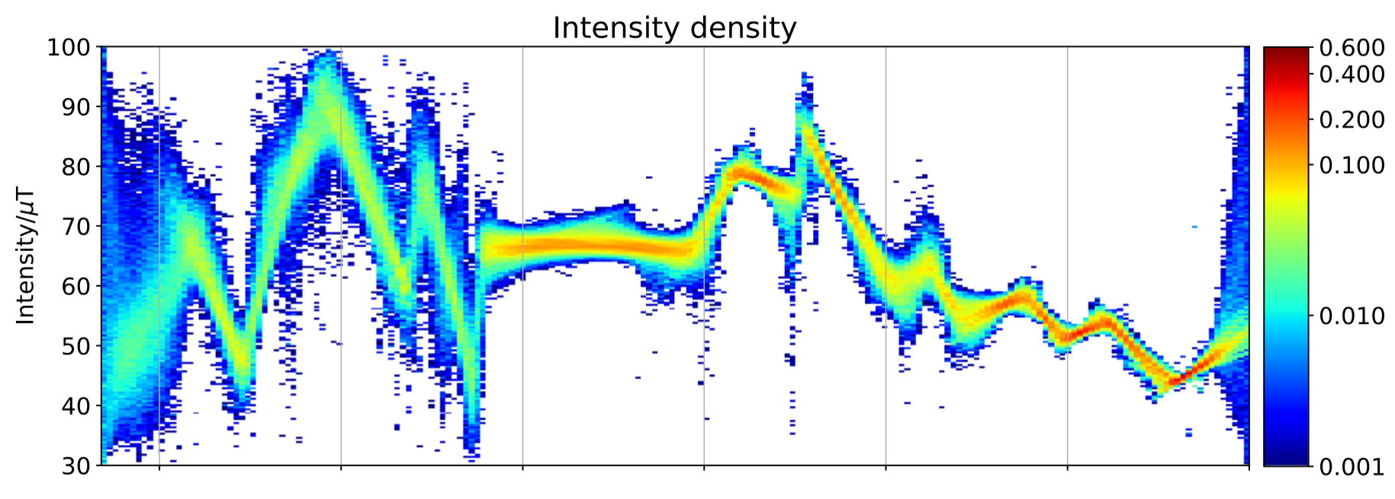
Transdimensional Bayesian inversion:
Can we do the same for the extreme value dataset?
Livermore et al. (2018)

Slide 13
Synthetic test
Given the supermag data distribution:
Replace all data by synthetic draws from GPD with
(reasonable
from previous
work)
Can we reproduce the model?

Slide 14
Limited or no data

Slide 15
Preliminary results: extreme value dataset
Data consistent with smooth variation with latitude, except around 70 degrees

Slide 16
Scale: data require complex variation with latitude

Slide 17
Comparison to MLE at each observatory
ESK

Slide 18
Comparison to MLE at each observatory
ESK

Slide 19
Conclusions
Work in progress..
Overall smoothest Bayesian model consistent with data is:
Shape – smooth variation with latitude, small uncertainties
Scale – significant variation with latitude, large uncertainties
Suggests similar physical mechanism everywhere but scale depends on local effects but on a larger scale.

Slide 20
Future work..
Need to work through 200-yr return values (with uncertainties)
What’s going on at ESK?

Slide 21
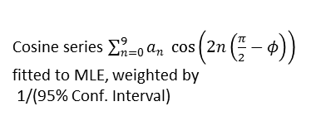
200-year return levels
Cosine series $\sum_{n=0}^{9}{a_{n} \cos\left(2n\left(\frac{π}{2}−φ\right)\right)}$
fitted to MLE, weighted by
1/(95% Conf. Interval)

Slide 22
Magnetometer

Slide 23
SuperMAG data processing
DRAFT
The magnetic field measurements for this study were provided by SuperMAG, a global consortium of data providers led by Johns Hopkins University (Gjerloev, 2009).
From Gjerloev (2012): The field measurements (1-minute averages) were rotated into a local NEZ geomagnetic coordinate system (N = north, E= east, Z = down) using a time-dependent local declination angle obtained using a 17-day sliding window smoothing filter.
For each magnetometer, the N, E and Z components were then individually baselined as follows:
  (i) Diurnal variations of the field were removed by subtracting a diurnal trend,
  (ii) the secular variation of the Earth’s main field was removed by subtracting the linear trend over each year (with some contribution from neighbouring years), and
  (iii) the residual scalar offset was subtracted.
This method of processing preserves the short-term field fluctuations associated with substorms, as well as those due to geomagnetic storms. Long-period (>1 month) variations in the declination angle are, however, removed by the rotation into local NEZ coordinates.

