Slide 1
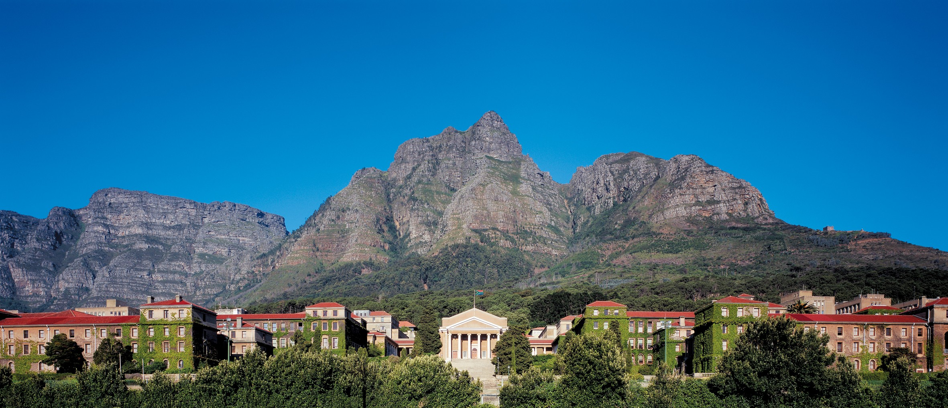
Power system disruption by GICs
SWIGS, Cambridge: Sep 2019
CT Gaunt
Power Systems Research Group, UCT

Slide 2
Space weather – power systems?
Science fiction?
Real effects?
What interests?
Knowledge in:
Science – connection between Sun and Earth
Engineering – systems’ responses to stress
Society – need to mitigate effects

Slide 3
Big system
SUN: corona to ground
B-field
E-field
GIC
Other stresses
Transformer
Power system
Degradation
Load loss
Cost

Slide 4
Failure routes
Transformers:
Insulation degradation by lightning, overheating or mechanical: GICs cause overheating.
Network:
Loss of stability – transient stability, voltage stability: GICs reduce efficiency of delivery.
Protection:
Relay maloperation: GICs distort relay inputs.

Slide 5
What we are investigating
B-field to E-field to GIC
Transformers’ electrical responses to GIC
Transformer degradation
Distortion of waveforms in the system
Reduction in power transfer efficiency
Cost of disruption

Slide 6
B → E → GIC
Problems:
Much misleading information about character of GMDs.
The B, deltaB or dB/dt (dH/dt) → E model is not resistive; time domain integration period is vague.
Earth conductivity data mostly unavailable.
The E → GIC model ignores power system inductance.
Preliminary findings:
SC does not occur everywhere at the same time.
Identifiable time delay in power systems.
We believe we have a B-field → GIC transform.
Several papers to be submitted in 2-10 weeks.

Slide 7
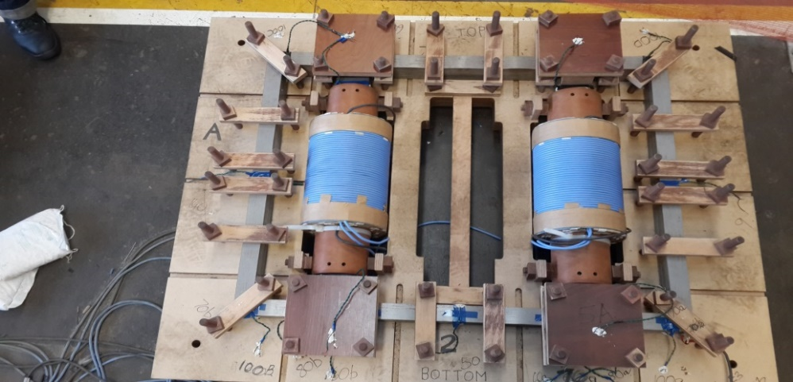
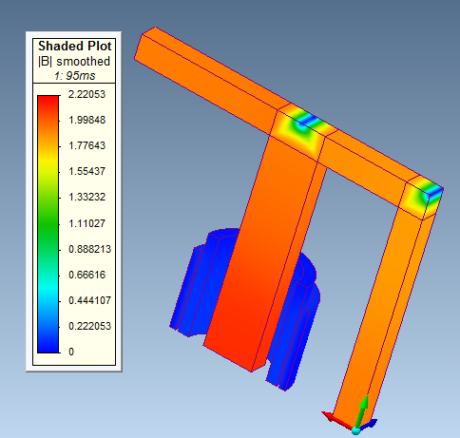
Transformers’ electrical response to GIC
Consistent models of 1p4L physical measurement, equivalent circuit and FEM.
(1 paper at Powertech in June, another submitted).
Localised low flux density due to rapid flux direction change
150 t winding
80 t winding
Deep core saturation

Slide 8
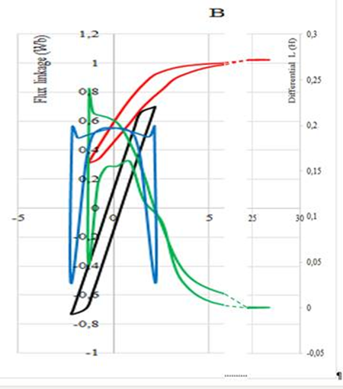
Extend to other cores
Identify incremental inductance.
Physical model measurement and FEM analysis of 3p3L and 3p5L transformers in progress.
Others planned.

Slide 9
Transformer degradation
Low Energy Degradation Triangle (LEDT)
More transformers analysed
LEDT extended to MEDT (medium energy) and ester oils.
Problems
Many utility records too poor for analysis, of trends (often) and causes (nearly always).
Difficult to validate extended laboratory models of degradation initiation.

Slide 10
Power system incidents
Too few GIC-initiated problems to characterise
Utilities do not reveal events – despite which …
growing records of protection, damage and collapse events.

Slide 11
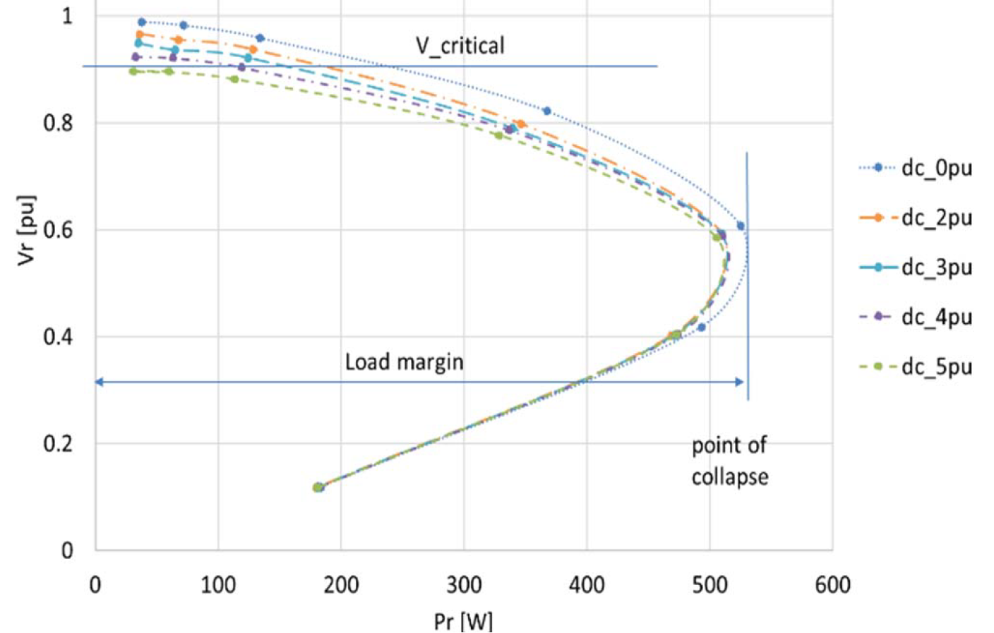
Power transfer efficiency
Weak models
Conventional analysis is based on voltage stability with extra reactive power.
Exposure risk to GICs is simplistic – assumes symmetrical distortion.
Our models show distinct half-wave effects on voltage.
Generation exciter ignored – we show significance.
Cascading collapse models very weak.
2 papers accepted (IEEE Africon), 1 in preparation

Slide 12
What is reactive power?
Most electrical engineers do not know.
Definition of apparent power and reactive power based on balanced sinusoidal waveforms.
Under GIC conditions:
waveforms are not sinusoidal;
phases are not balanced;
network impedances are frequency dependent.
Definitions of AP and reactive power do not apply.
New WGs formed this year to revise IEEE and IEC (ISO) standards.
1 UCT paper in advanced stage of preparation

Slide 13
Disruption costs
Economic and financial costs change with point of view: national or owner.
Complex models use scarce data:
Industry-by-industry national input-output tables analysed by hypothetical extraction method to assess sector shock.
Multi-regional input-output table with disparate shocks across sectors.
Social costs? Recent experience in UK.

Slide 14
Where are we?
Modelling assumptions are invalid. Models are not good enough for prediction.
Science:
Range of GMD characteristics? B → E → GIC models?
Engineering:
Transformer response? Reactive power? System voltage collapse risk?
Economic/Social:
Value@Risk relative to mitigation costs?

