Slide 1
Space Weather Impact on Ground-Based Systems
Annual Workshop #3
SWIGS Annual Workshop – Cambridge, September 2019

Slide 2
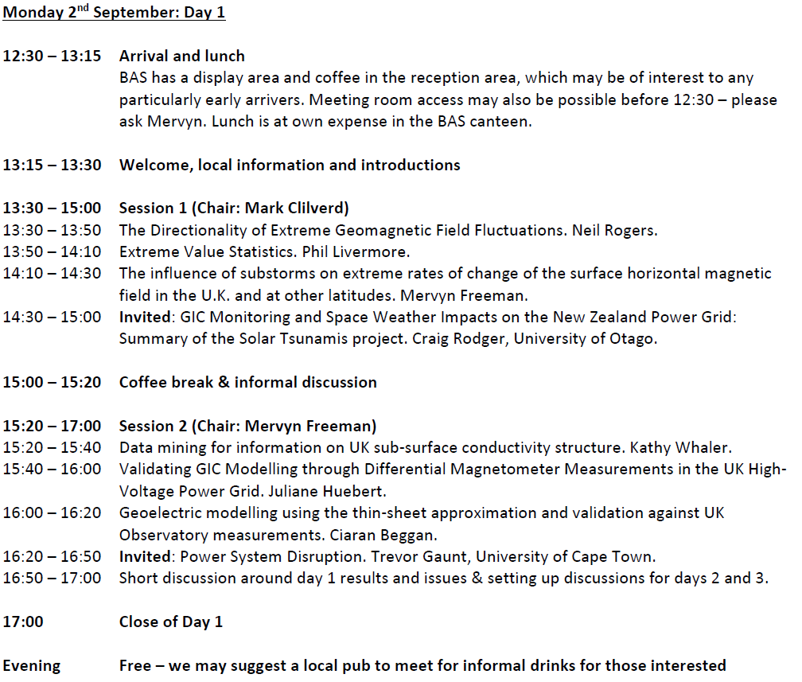

Slide 3
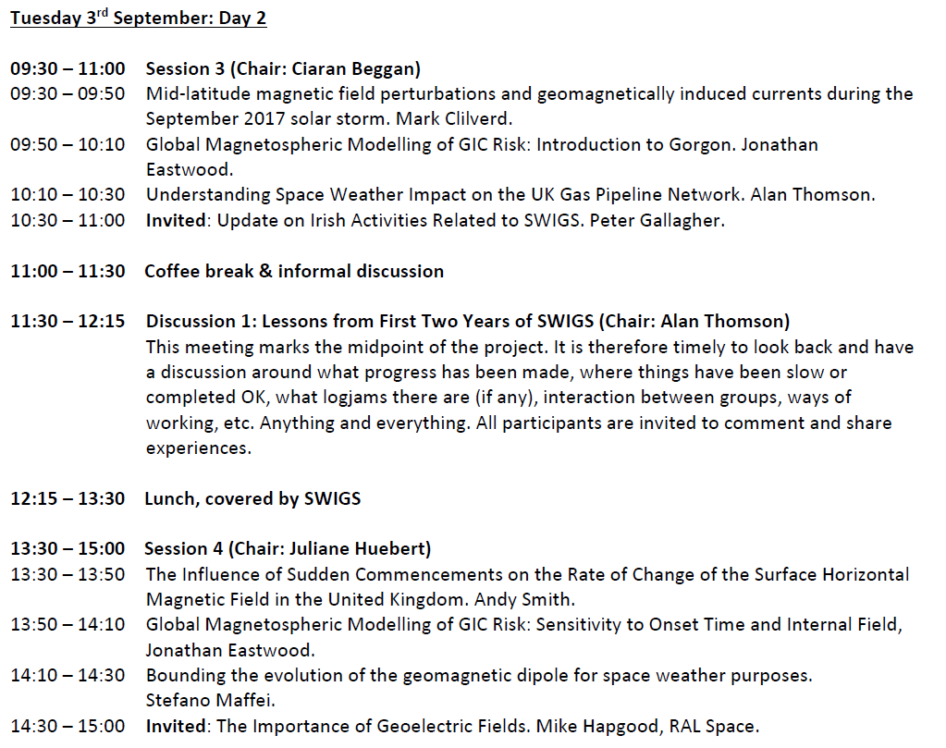

Slide 5
Discussion 1: Lessons from First Two Years of SWIGS
This meeting marks the midpoint of the project. It is therefore timely to look back and have a discussion around what progress has been made, where things have been slow or completed OK, what logjams there are (if any), interaction between groups, ways of working, etc. Anything and everything. All participants invited to comment.
A reminder of last year’s emergent ‘themes’ where we felt at the time, there was collaboration potential:
Theme 1 = “What causes the Eskdalemuir dB/dt anomalously large return level/period”
Theme 2 = “Better modelling of the expansion of auroral oval”
Theme 3 = “Reversals/longer scale core field changes and implications for SW impacts”
Theme 4 = “Carrington event: modelling the chain of solar wind to GIC processes”

Slide 6
7. Deliverables
The project team will deliver the following, in respect of our Aims and Objectives:
World-leading research into coupled ground-ionosphere-magnetosphere electromagnetic processes, including advances in understanding and modelling of processes on different spatial and temporal scales throughout the ground-ionospheric-magnetospheric system
New models of how infrastructure GIC responds to drivers in solar wind and in the M-I system
Development of detailed statistical models of GIC in relation to geophysical variables
New models of surface electric fields in the UK, through an updated model of the 3D conductivity structure of the UK, and an improved understanding of how surface electric fields in the UK vary in response to space weather forcing, particularly at the coast, where there is strong dependence on deep and shallow conductivity structures
A detailed measurement campaign at a number of key sites, to investigate source field scale size issues and dynamics, creating legacy data sets of GIC, electric field and conductivity

Slide 7
Application and development of existing operational MHD models (GUMICS, Gorgon) of the magnetosphere, predicting ground-level magnetic variations, which will be used to forecast GIC in the UK, including quantification of uncertainty and the forecast time horizon
Quantification of the importance of the morphology of Earth’s internal magnetic field on space weather impact, through better forecasting of decadal scale change in the core field and better understanding of long-term evolution of auroral and other current systems
Quantification of extreme events and understanding of how M-I processes change under increasing external forcing
Adaptation of numerical weather ‘downscaling’ techniques, for the space weather situation

Slide 8
A new model of the electrical transmission system of the UK to model and forecast GIC in the transformers in the network, through collaboration with National Grid
Quantification of the significance of source field scale size (local, meso, large) for large magnetic field rates-of-change and GIC production
Several ‘first-ever’ deliverables: UK railway and gas pipeline transmission network models and an analysis of GIC flows in these; analysis of a railway ‘anomaly’ database in relation to space weather events; analysis of transformer dissolved gas across the transmission network
Major, high-impact research papers in internationally important journals on all these deliverables, as well as presentations at major international meetings and on-line information and summary papers for the public, industry, insurance sector and government

Slide 9
Discussion 2: Odds and Ends
Short discussions (10 mins approx.) on specific items raised by the consortium.
Showing 1 or 2 slides might be possible
Mike Hapgood: Promoting a shift in UK risk assessment of GIC risk: from dB/dt to the geoelectric field
Mike Hapgood: Opinions on AGU’s latest data policy developments? https://publications.agu.org/author-resource-center/publication-policies/data-policy/data-policy-faq/
Phil Livermore: Implications of the recent shift in the north magnetic pole?
Craig Rodger: What do the power grid operators want from Space Weather researchers?
David Jackson: Update on Implementing the Space Weather Modelling Framework
Alan Thomson/Mike Hapgood: SWIGS at Royal Society Summer Science Exhibition 2020/2021? https://royalsociety.org/science-events-and-lectures/2019/summer-science-exhibition/ Other outreach opportunities?
Alan Thomson: ESSW Topical discussion meeting on GIC http://www.stce.be/esww2019/program/tdms.php
Alan Thomson: Let’s make an early decision on date of next annual meeting
Alan Thomson: Any lessons of the recent UK local grid blackout: the aftermath of a severe space weather event?

Slide 10
Discussion 3: Next Steps and Future Plans
All participants to outline their next steps and use this opportunity to indicate where collaborative efforts are needed, if not already agreed.
What/where are the upcoming meetings and research opportunities that we should be aiming for?
What are the bright new ideas we should work on, even looking beyond SWIGS?
How do we make SWIGS more than just the sum of the various parts?
Is/could anything from one WP be useful to another WP?
Is anything emerging that is useful to end users, besides improved understanding?
Anticipating mainly a discussion but if you have a slide or two to show, that can probably be accommodated.

Slide 11
Meetings, Workshops, Outreach & Events

Slide 12
Other Info - Project Partners
Dublin Institute for Advanced Studies (Dublin, Ireland). P. Gallagher has complementary expertise on GIC research, modelling and field measurements across Ireland.
Met Office (Exeter, UK). D Jackson is expert on ‘research to operations’ space weather model development.
Natural Resources Canada (Ottawa, Canada). D. Boteler will advise the project on GIC related research and industry involvement (including pipelines, railways) from North America.

Slide 13
Other Info - Project Partners
University of Otago (Dunedin, New Zealand). C. Rodger will advise on a New Zealand industry & government project (‘MBIE’) to model GIC in South Island’s transmission system.
SuperMAG (JHU, Baltimore, USA). J Gjerloev will assist in accessing and analysing worldwide magnetometer data supplied through SuperMAG.
Finnish Meteorological Institute (Helsinki, Finland). A Viljanen led the FP7 EURISGIC project (‘European Risk from GIC’). He will advise on modelling GIC in power grids, measurement of GIC by the gradiometer technique, and European activities in GIC research.
University of Cape Town (South Africa). C. T. Gaunt is a power engineering expert with wide experience in industry issues and will advise on transformer impact and industry needs.

Slide 14
Other Info - Project Partners
University of Göttingen (Germany) K. Bahr will make available magnetotelluric equipment for WP2 (~£250k value) and provide in-kind support.
University of Frankfurt (Germany) A. Junge will provide conductivity information deduced from 10 long period sites in south-east Scotland.
Beihang University (China). Jin Bin Cao will provide support to Dunlop and is independently recruiting PDRAs who will visit RAL to support the project.
North China Electric Power Uni. Lianguang Liu will provide advice on Chinese GIC risk

Slide 15
Other Info - Stakeholders
National Grid (power) – Andrew Richards (Severe Risk and Resilience Analyst, Head of SW)
Scottish Power (power) – Finlay Macleod (System Performance Lead Engineer)
MunichRe (insurance) – Jan Eichner (Head of NatCatSERVICE, Geo Risk Research)
Atkins (railways) – Geoff Darch (Head of Climate Risks and Adaptation), Les McCormick (Practise Manager, Electrical Systems)
National Grid (pipelines) – Quintin Mabbutt (Innovation Delivery Manager)
Met Office Space Weather Operations Centre (all ground-based impacts & WMO) – Mark Gibbs (Head of SW)
UK Space Agency (international activities) – Mike Willis (Head of Security and Spectrum Policy)

