Slide 1
Met Office Activities related to SWIGS
David Jackson
SWIGS Meeting, Cambridge, UK
2nd – 4th September 2019
@MetOfficeSpace

Slide 2
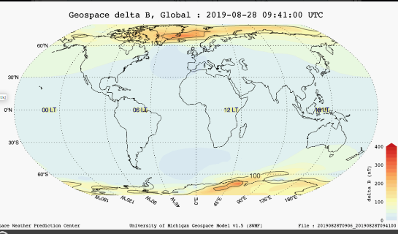
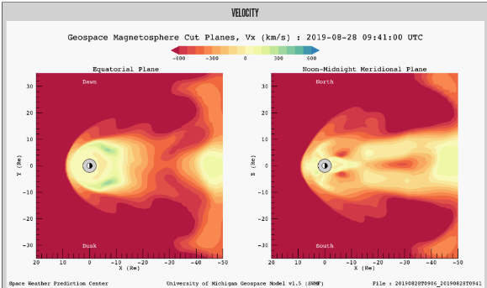
SWMF Implementation
As SWPC with 3 components:
BATS-R-US MHD mag/sphere model
Ridley Ionosphere e/dynamics Model
an inner mag/sphere ring-current model
Operational implementation planned for ~Feb 2020
SWIGS connection: comparison with GORGON? (eg similar operational / pre -operational periods)

Slide 3
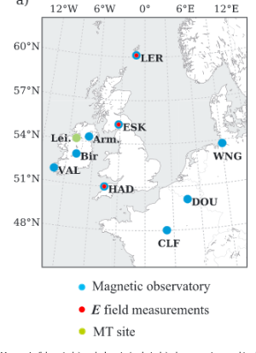
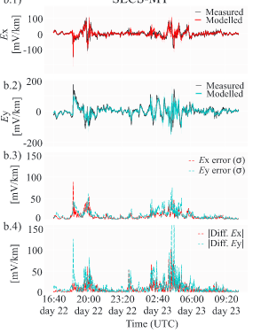
Use observations and interstation tensor relationships to model geoelectric field Works for quiet and storm time conditions Can differentiate between local and regional geomagnetic sources Possible next step: move from research to operational UK/Ire nowcast system
E field at ESK during June 2015 storm
Notes:
As an introduction, this is a background of the driver behind space weather at the Met Office and set the context of what our role is.

