Slide 1


Data mining for information on UK sub-surface conductivity structure
Kathy Whaler and Juliane Huebert

Slide 2
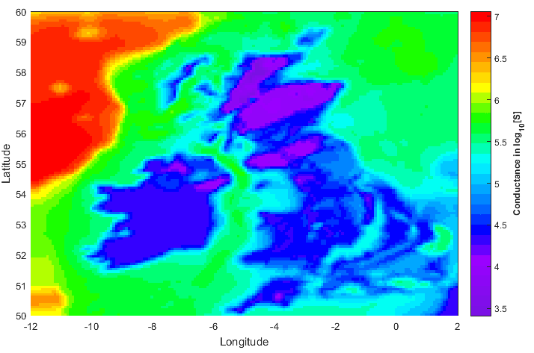
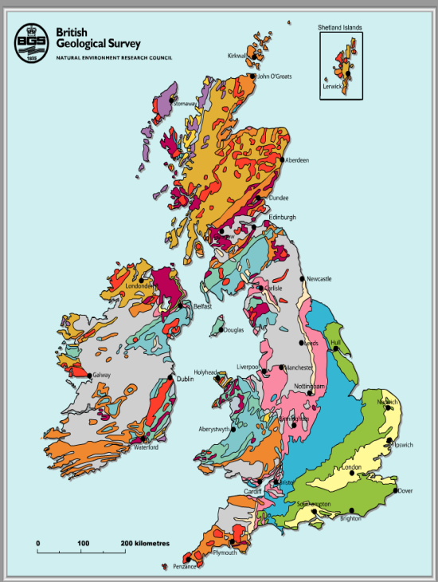
Conductance model
Conductance model from UK bedrock map – transfer into conductivity model for upper 3km

Slide 3
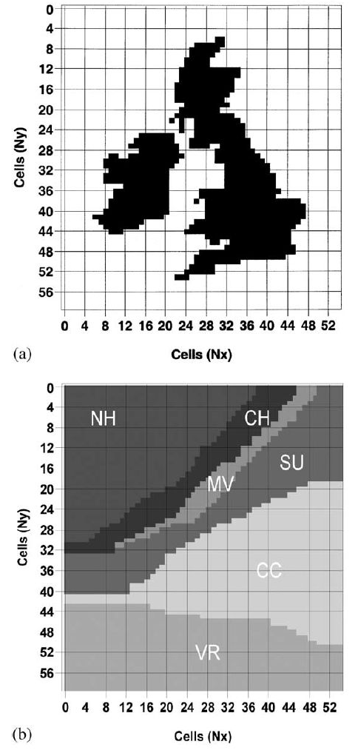
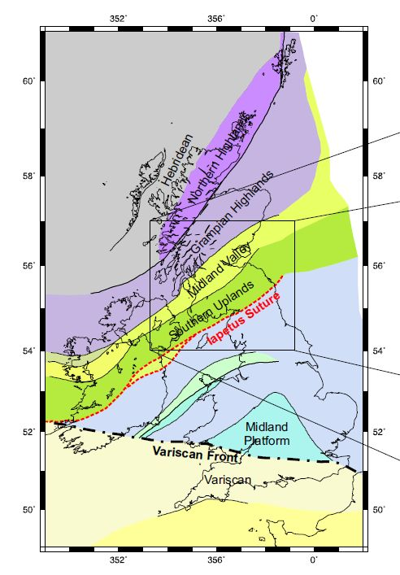
Block model
Electrical resistivity at depth block model after UK tectonic terrains (McKay thesis and Beamish 2002)

Slide 4
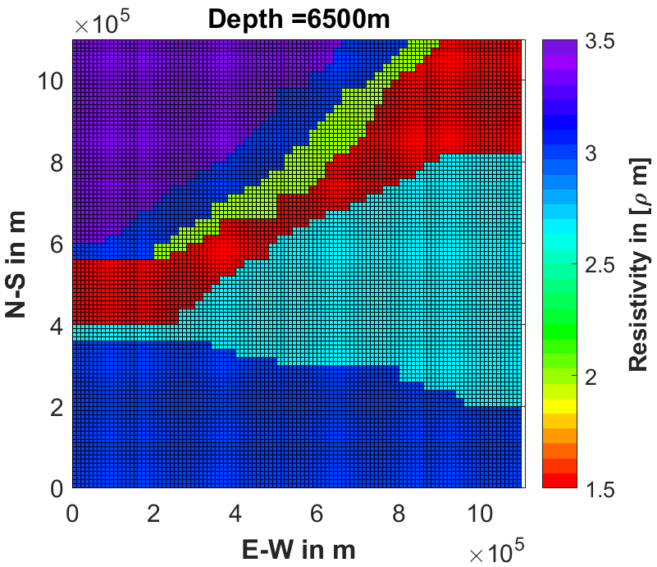
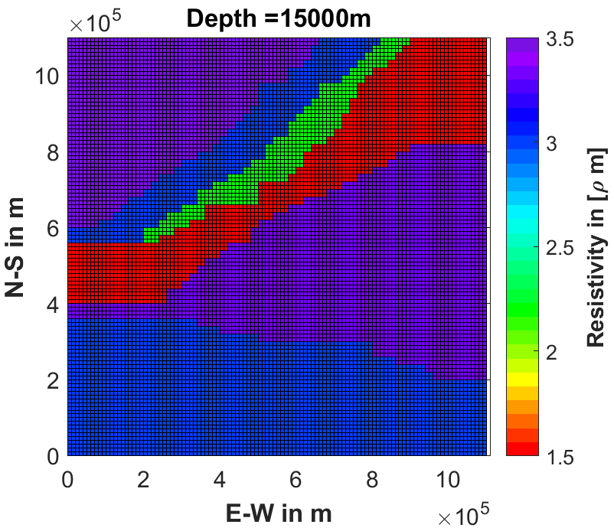
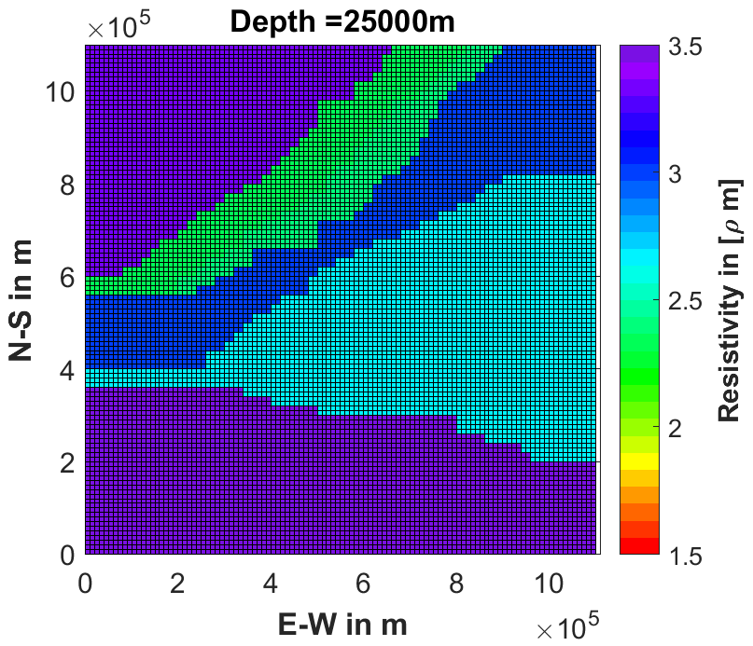
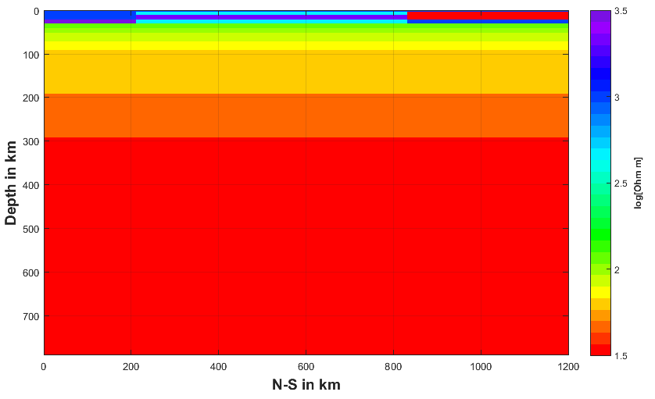
Block model
Layered conductivity below 25 km

Slide 5
Eskdalemuir anomaly
Note reversal in short period event at 12.40 h
But no reversal for longer event at 15.30 h
S
N
Magnetograms along N-S line through Eskdalemuir (ES)
Edwards et al. (1971)

Slide 6
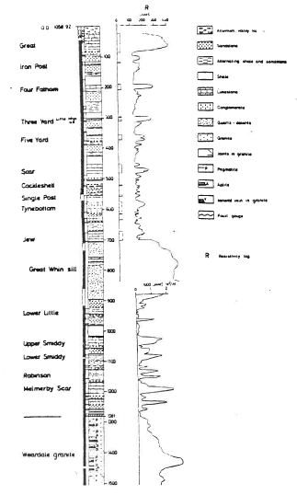
Rookhope borehole
Upper limestone (high resistivity)
Middle Limestone group – thin limestones, shales, sandstones and thin coals (185 m thick)
Whin Sill – quartz-dolerite, high resistivity (55 m)
Carboniferous sediments – lower Limestone group (120 m)
Granite basement

Slide 7
Induction vectors at 144 minutes (left) and 40 minutes (right). Real part solid, imaginary part dashed.

Slide 8
Summary of Edwards et al. (1971)
Imaginary parts of induction vectors abnormally large
Concluded intense concentration of current flows NE to SW through Eskdalemuir
Seen at all frequencies but particularly prominent at 40 s period, where induction vectors reverse sign from N to S through region
Parker (1968, PhD thesis) analysed data for Eskdalemuir group of stations
Cites Jain and Wilson (1967) MT study – period range 8 s to 100 m
They found 12 km of material with resistivity (assumed) 3000 Ωm, underlain by 18 km of 45 Ωm, basement 2500 Ωm
Results not particularly sensitive to assumed top layer resistivity

Slide 9
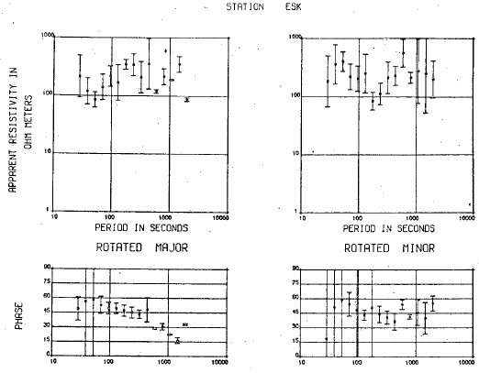
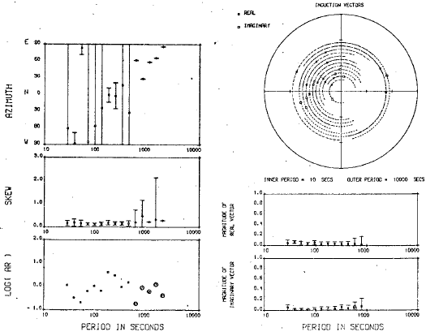

Eskdalemuir MT and GDS data
Real
Imaginary
AR is the anisotropy ratio = $\frac{ρ_{major}}{ρ_{minor}}$
Jones, A G, 1977, Geomagnetic Induction Studies in Southern Scotland, PhD thesis, University of Edinburgh

Slide 10
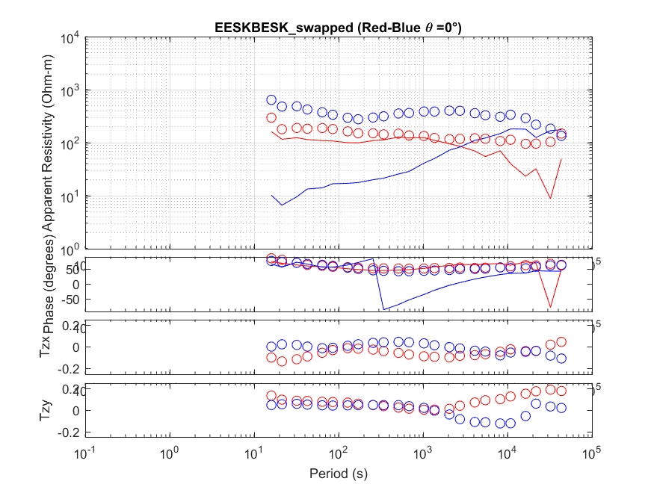
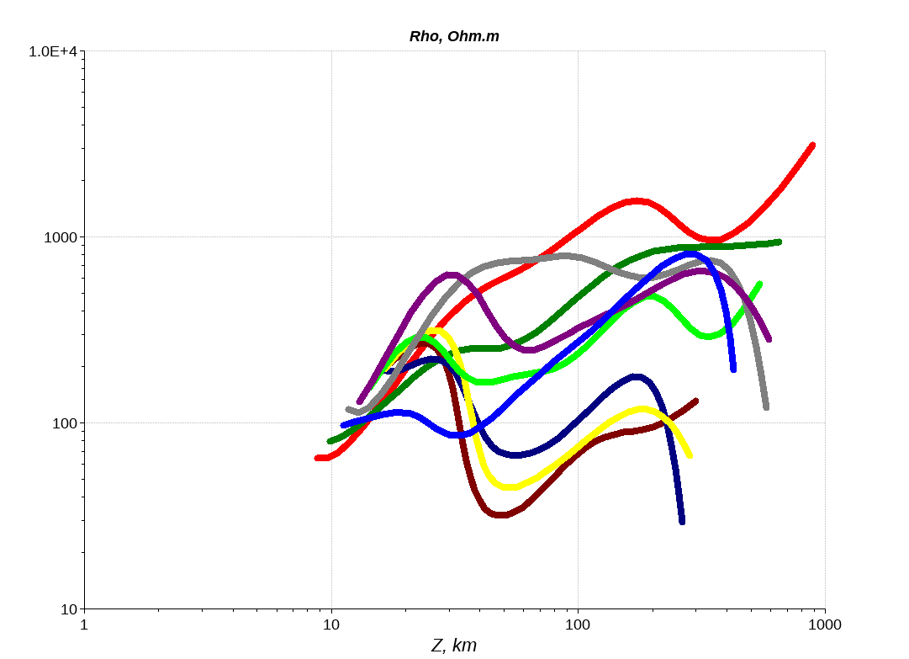
MT transfer functions
(using the electric field time series from 2013-2017)
1D inversion models

Slide 11
Comments
Conductor beneath southern Uplands at lower crust/upper mantle depths
ESK is not a typical southern Uplands station – ρ_{major} minimum at 50 s and maximum at 200 s periods not seen at other sites
But induction vectors in broad agreement
Eskdalemuir anomaly is not the simple structure proposed by Edwards et al. (1971) – much more complex structure required to fit MT and GDS data
Also undertook hypothetical event analysis for current flow

Slide 12
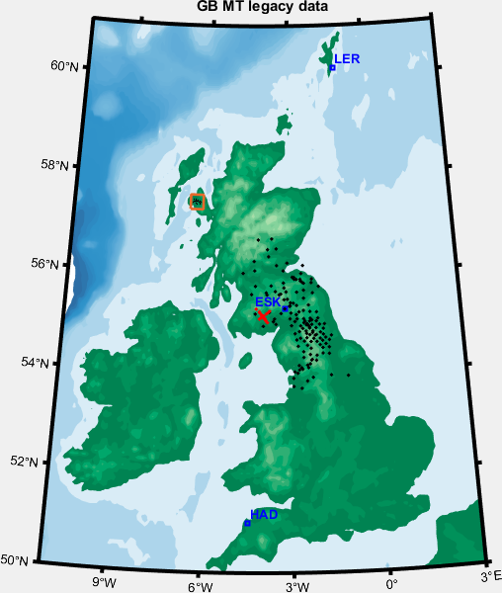
Location of legacy MT data
Simba and Iapetus data are of modern standards, legacy data with limited frequency range (sometimes only 1 data point at 60s) and usability (some data in ‘cph’ – cycles per hour)
MT transfer functions are available from geomagnetic observatories (electric field collection since 2012)
Simba data set
-- Iapetus suture zone
Legacy MT data

Slide 13
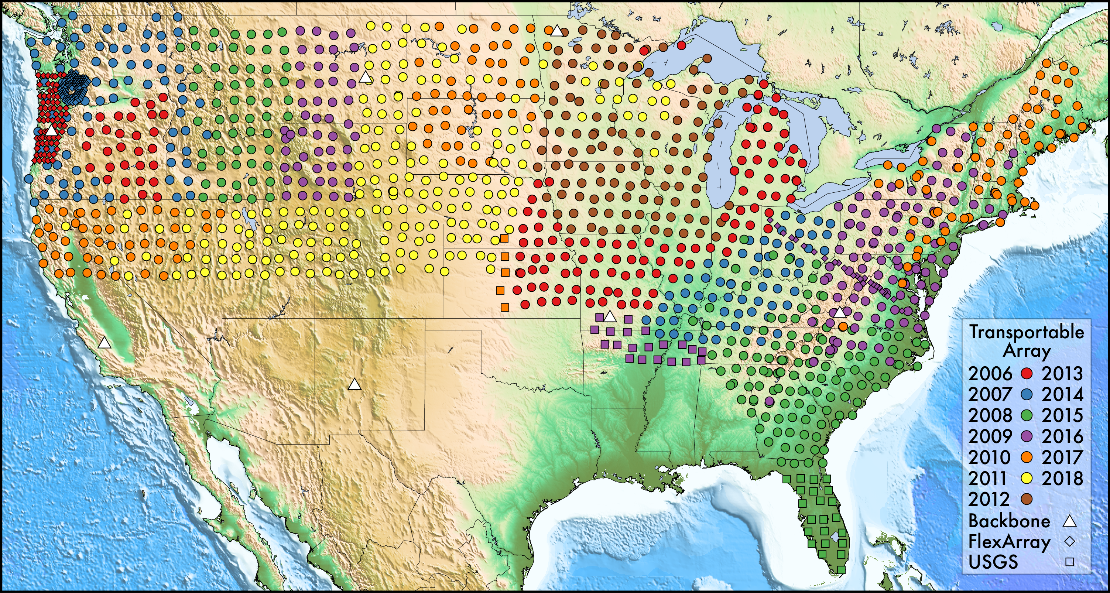
US MT array

