Slide 1
Understanding Space Weather Impact on the UK Gas Pipeline Network
Gemma S Richardson, Alan W P Thomson
British Geological Survey, Edinburgh, UK
SWIGS Annual Workshop – Cambridge, September 2019

Slide 2
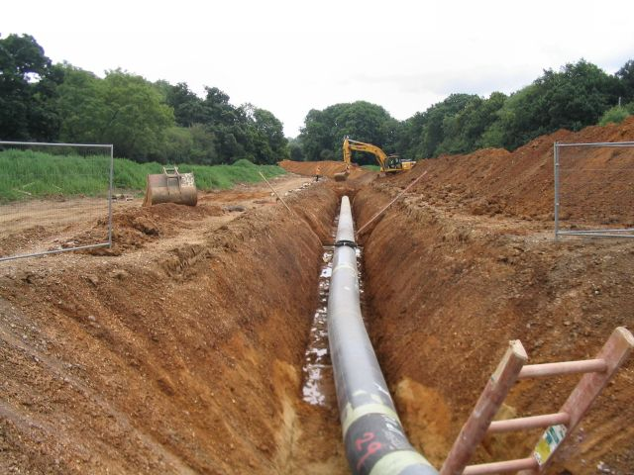
Pipeline Basics
Gas transmission/distribution pipelines usually buried
Diameters between 3 inch (0.076 m) and 60 inch (1.52 m)
Carrying flammable gases at pressures up to 410 kg/cm².
A galvanic current circulates between metal pipe and medium
Depends on electrical conductivity of the surrounding soil
May cross terrains of different conductivity
Anti-corrosion method #1: Non-corrosive coatings
e.g. asphaltic tape
Deficiences, incomplete application, defects during burial, aging
Rosemary Oakeshott - Gas pipeline internment CC BY-SA 2.0
Anti-corrosion method #2: Cathodic protection
To avoid anodic current flow from the pipe to the soil
the corroding object forms the cathode in galvanic cell, the anode being a base metal which is sacrificed to keep the potential of the metal object negative and at a value below its steady state corrosion potential in the soil burial environment (Osella et al, 1998)
Good protection for steel at -0.85 V using a CuSO4/Cu half cell as the soil contact reference (Feliu and Andrade, 1991)
This corresponds fairly well to the equilibrium potential of iron in a dilute Fe2+ solution

Slide 3
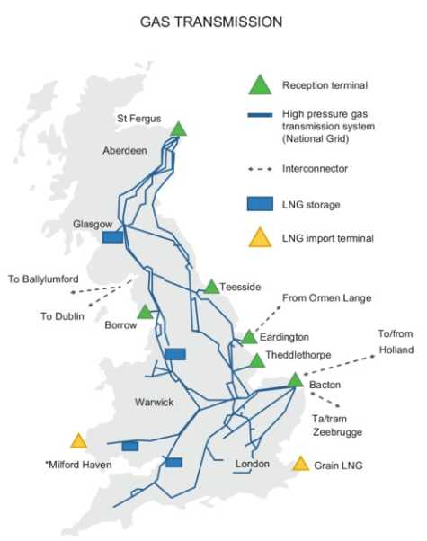
UK Pipeline Modelling
UK has extensive high pressure gas transmission network (run by National Grid Gas plc)
7,600km of pipelines which transport gas from coastal terminals and storage facilities to exit offtake points (to 8 distribution networks and power stations and large industrial consumers)
Pipelines are coated in a low conductance material and maintained at a slightly negative potential in relation to the Earth to minimise corrosion (‘cathodic protection’)
Space weather takes the pipe-to-soil (PSP) potential into the corrosion regime for the pipe
Pipeline PSP not previously been modelled in UK
Somewhat similar to modelling GIC in a power network but with subtle differences (e.g. continuously earthed)
National Grid (CC BY 4.0)
Notes:
Previous research in Scandinavia and N America and some in NZ

Slide 4
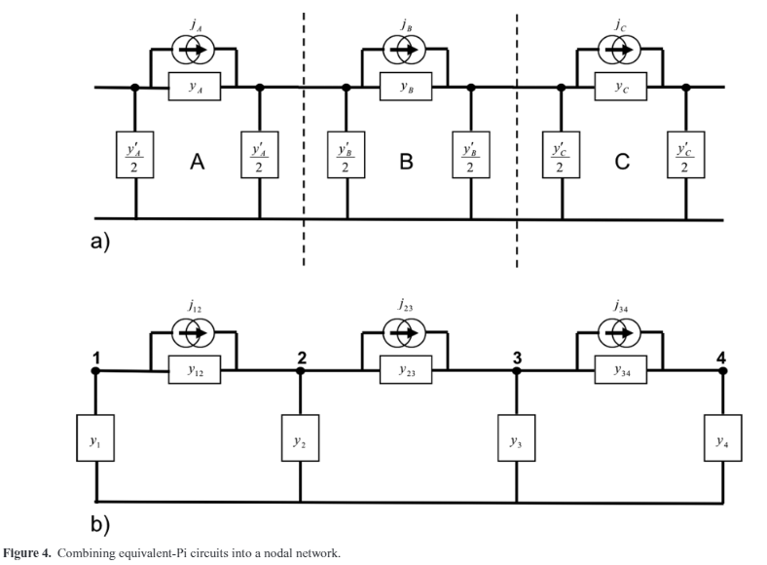
Methodology
Following the method of D. Boteler (GJI, 193(1), 98-109, 2013)
Spilt the pipeline up into sections that are short enough that the electric field can be considered constant in each section
Develop ‘equivalent-pi’ circuit to describe induction in the pipeline
Combine equivalent-pi circuits for each section into a nodal admittance network
Matrix equation involving admittances and current sources
Solved for voltages at any node in the pipe
Pipe segment A
Pipe segment B
Pipe segment C
Notes:
Nodal admittance matrix

Slide 5
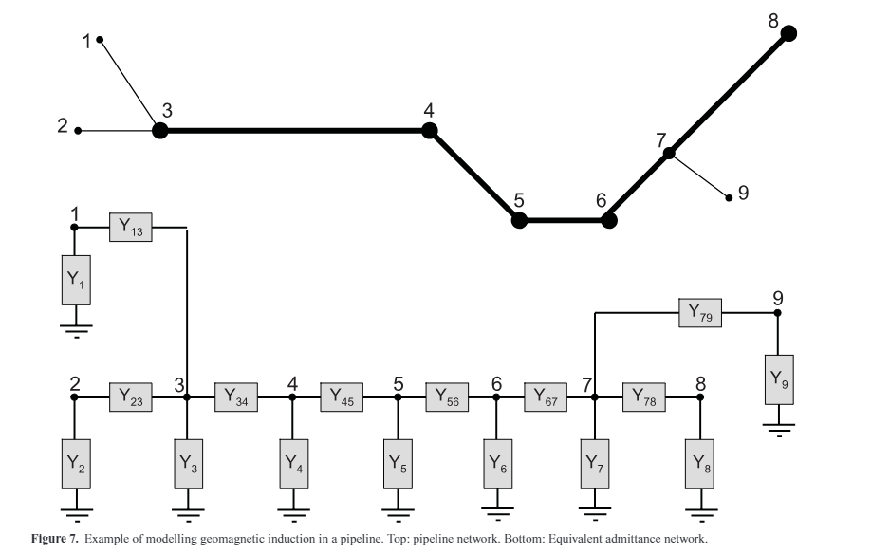
Benchmark Test Network
Main pipeline (thicker line):
Pipe diameter = 30 inches (762mm)
Wall thickness = 15.6mm
Branch lines
Pipe diameter = 15 inches (381mm)
Wall thickness = 10mm
Pipeline steel resistivity assumed at 0.18x10⁻³ Ωm (standard value)
Coating conductance assumed at 5x10⁻⁶ Sm⁻² (typical modern value)
~300 km

Slide 6
Calculated electrical properties of the pipe
Series impedance, $Z= \frac{ρ}{π(r_{0}^{2} − r_{1}^{2})}$ Ωkm⁻¹,
(r₀ and r₁ are outer and inner radius of the pipe, rho=resistivity)
Parallel admittance, $Y=C 2πr_{0}$ Skm⁻¹,
(C is pipe coating conductance)
 | Series impedance | Parallel admittance | Characteristic impedance (Z₀) | Propagation constant (γ)
Main | 0.004921 | 0.011969 | 0.641174 | 0.007675
Branch | 0.015444 | 0.005985 | 1.606393 | 0.009614

Slide 7
Sanity Check – PSP in the Test Model
Node | Nodal Voltage for 1V/km Northward Electric field |  | Nodal Voltage for 1 V/km Eastward Electric field
 | D. Boteler | Our Model | D. Boteler | Our Model
1 | 29.7153 | 29.715939 | -94.2785 | -94.280670
2 | 2.8349 | 2.835069 | -98.6361 | -98.638225
3 | 2.9536 | 2.953804 | -72.3499 | -72.351619
4 | 6.2398 | 6.239826 | -3.5503 | -3.550413
5 | -23.6659 | -23.666313 | 11.0134 | 11.014549
6 | -23.6570 | -23.657365 | 33.5395 | 33.541490
7 | -3.6118 | -3.611995 | 45.8548 | 45.857434
8 | 36.4017 | 36.401818 | 81.0500 | 81.053222
9 | -20.8547 | -20.855088 | 61.9062 | 61.909042
~300 km

Slide 8
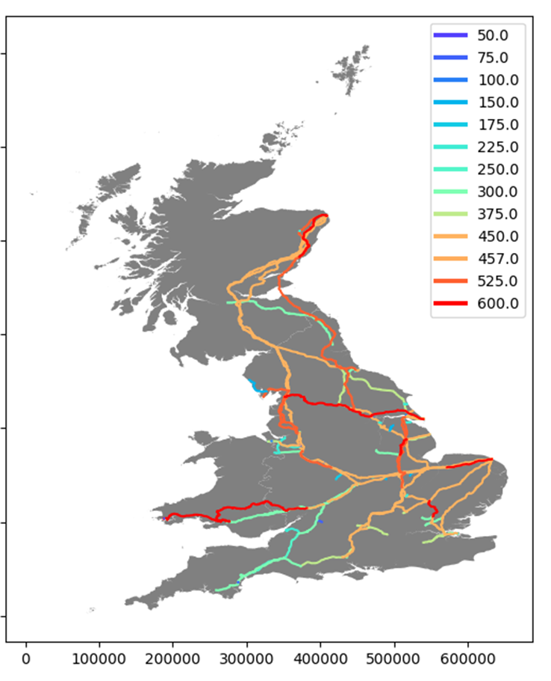
Constructing a ‘Real’ Network
Coloured by pipe radius (mm)
National Grid open source data includes shape-files that detail the pipeline topology
Pipe name
Diameter
Path of each line
However there is ‘missing’ information
Pipe wall thickness: assumed to be some small % of diameter (currently 2.5%)
Pipe resistivity: assume 0.18x10⁻³ Ωm
Coating conductance: assume 5x10⁻⁶ Sm⁻²
Data and assumptions from Boteler (2013)
Notes:
Need to make assumptions about the “missing” info – use values from Boteler 2013

Slide 9
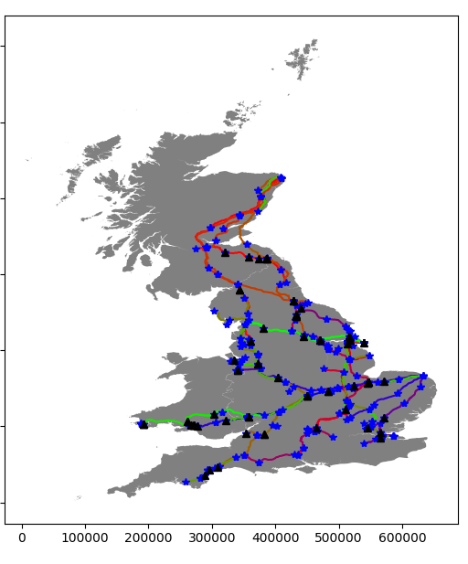
Coloured by pipe name/ID/section
Constructing a ‘Real’ Network
Stars are line ends (i.e. no obvious connection to next node) and triangles are junctions
Gap tolerance (i.e. how close nodes need to be to be considered electrically connected) was 6m for this example
In the network (and matrix inversion)
175483 nodes
175291 connections

Slide 10
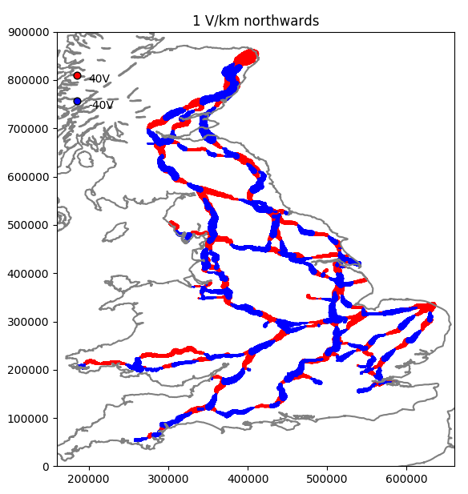
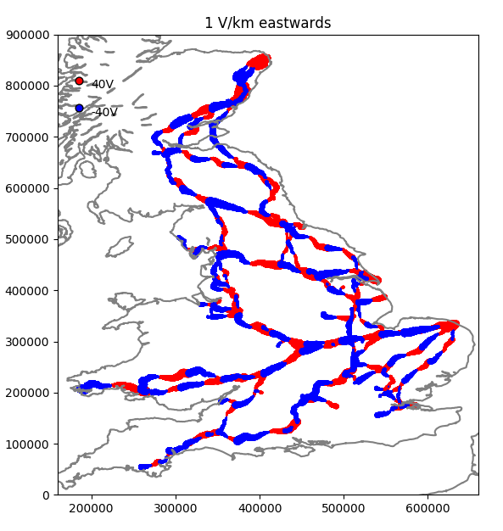
Uniform 1 V/km Electric Field: North and East
Max |PSP| = 65.2V
Max |PSP| = 45.0 V

Slide 11
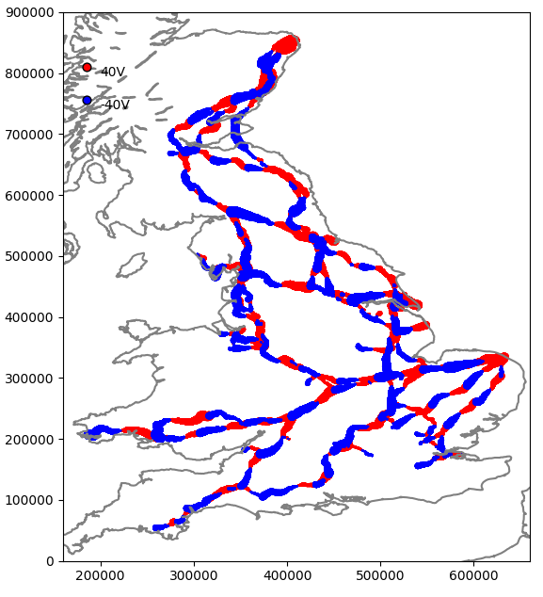
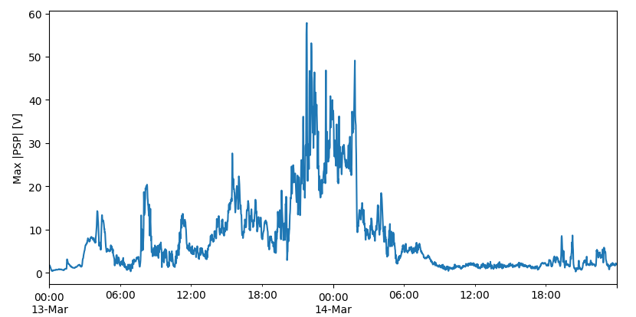
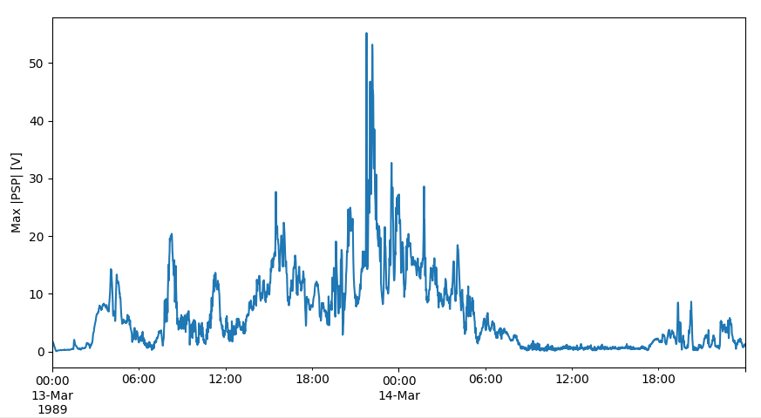
13th March 1989 Storm
1989-03-13 21:47:00
Max |PSP| = 62.40V
UK: 57V at 1989-03-13 21:47:00
Scotland: 55V at 1989-03-13 21:47:00

Slide 12
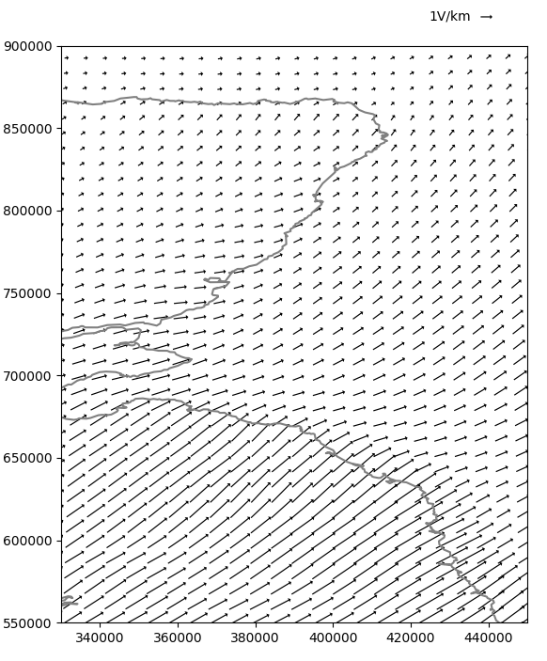
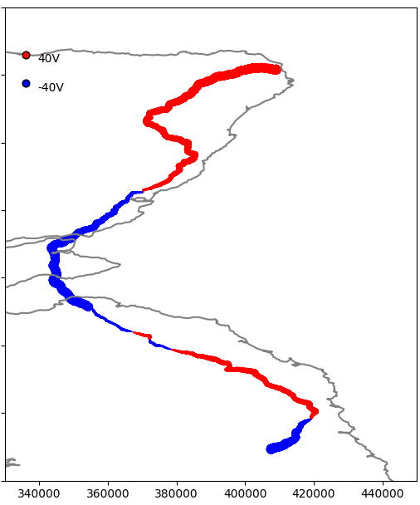
Single Pipe: E-field and PSP
E-field and PSP snapshot during the 13th March 1989 storm @ 21:46UT
Min = -55.21 V
Max = 51.25 V

Slide 13
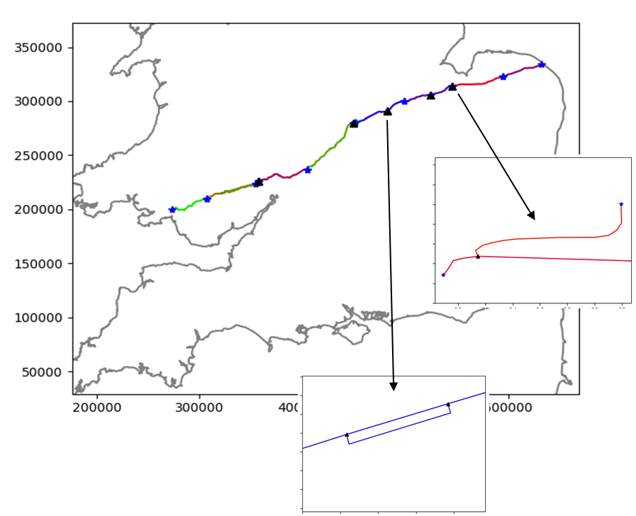
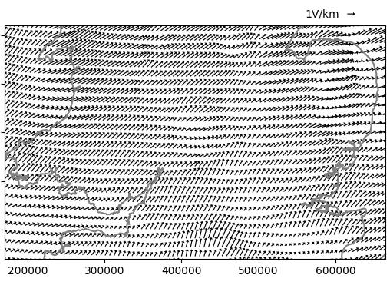
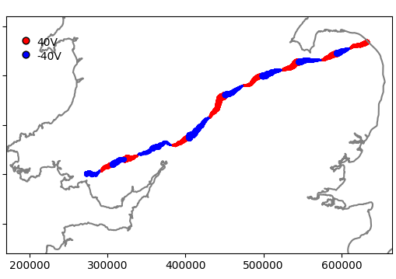
Single Pipe: E-field and PSP
E-field and PSP snapshot during the 13th March 1989 storm @ 21:46UT
Min = -28.47 V
Max = 32.37 V

Slide 14
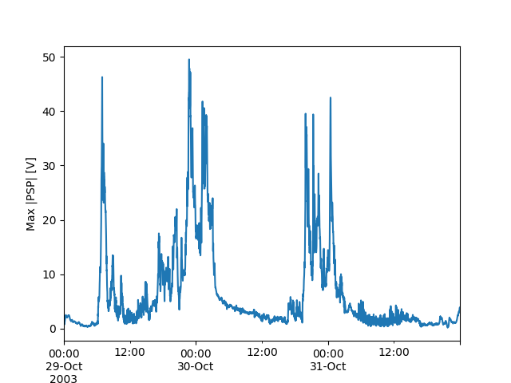
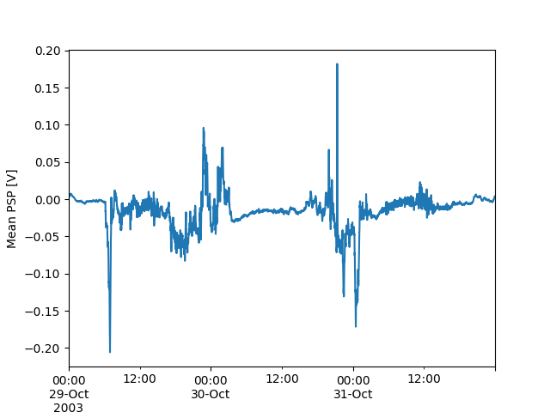
‘Halloween Storm’ of 29-31 October 2003
Maximum PSP (V)
Check: Mean PSP = 0V ?

Slide 15
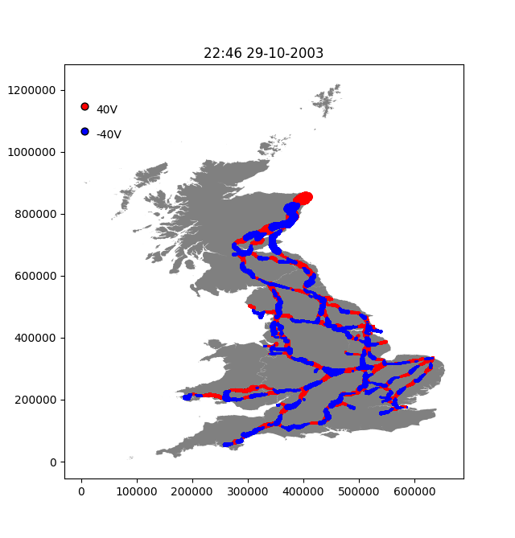
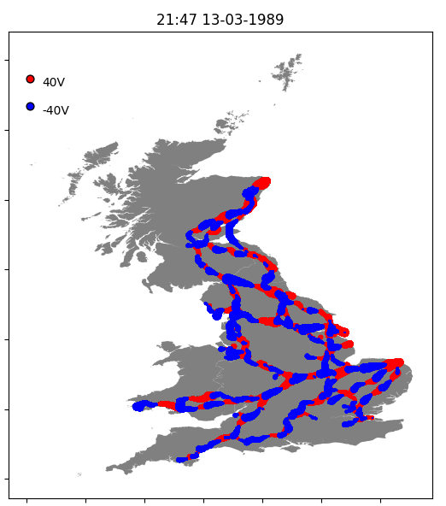
Comparison: 29th October 2003 & 13th March 1989
PSP at time of max PSP in network

Slide 16
Next Steps
Sensitivity analysis of PSP versus pipe characteristics
Diameter, thickness, coating conductance, electrical connectivity
Industry engagement to refine model and build ‘reasonable worst case scenarios’
Confirm pipe characteristics and connections
Estimated electric field strength and direction during the 13th March 1989 storm at 21:46UT

