Slide 1
MULLARD SPACE SCIENCE LABORATORY
The Influence of Sudden Commencements on the Rate of Change of the Surface Horizontal Magnetic Field in the United Kingdom
Andy Smith¹, Mervyn Freeman², Jonathan Rae¹, Colin Forsyth¹
¹ Mullard Space Science Laboratory, University College London, Dorking, UK
² British Antarctic Survey, Cambridge, UK
Credit: NASA
03 September 2019

Slide 2
Aims and Objectives
WP 1.1 – What is the role of the substorm in generating $δH/δt$ and GIC?
Task 1.1.1 – Substorms, rapid magnetic variations and GIC:
Assess the relative contribution of substorms to GICS
Decomposing distribution of $δH/δt$ by substorm phase
Extend previous substorm-only analysis
Assess whether substorms are critical for intense GICs
Analyze the relation between the substorm current magnitude, $δH/δt$ and GICs

Slide 3
Aims and Objectives
WP 1.1 – What is the role of the substorm in generating $δH/δt$ and GIC?
Task 1.1.1 – Substorms, rapid magnetic variations and GIC:
Assess the relative contribution of substorms to GICS
Decomposing distribution of $δH/δt$ by substorm phase [Freeman et al., 2019]
Extend previous substorm-only analysis [Smith et al., 2019, under review]
Assess whether substorms are critical for intense GICs
Analyze the relation between the substorm current magnitude, $δH/δt$ and GICs
New Investigation: What are the sources of large $δH/δt$?

Slide 4
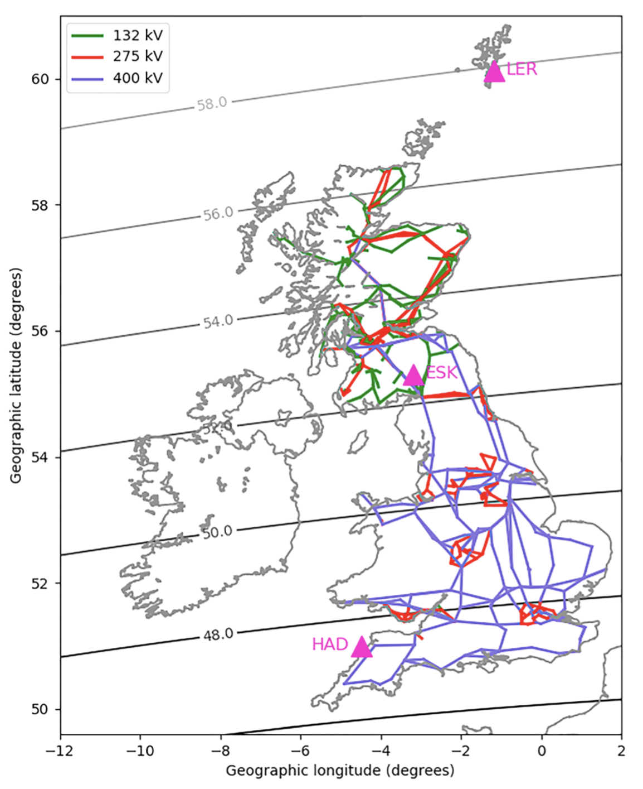
Progress & Outcomes: Sudden Commencements
Data & Motivation
21 years worth of data used (1996 – 2016), from three UK magnetometer stations.
We define the rate of change:
From Freeman et al., 2019:
Approximately 50% of large R in the UK are associated with substorm expansion and recovery phases.
Only 21-25% of large R during expansion and recovery phases is attributable to the substorm current wedge.
Therefore we investigate a non-substorm current wedge related source of large R: Sudden Commencements.
LER
ESK
HAD
Adapted from Freeman et al., 2019

Slide 5
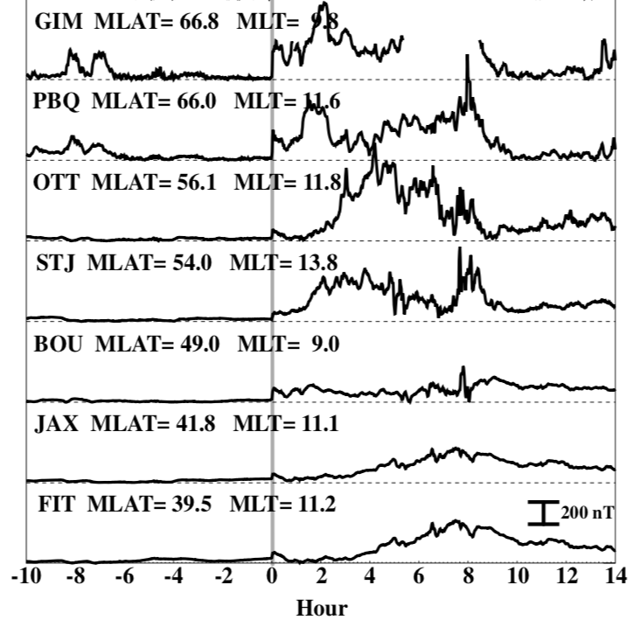
Progress & Outcomes: Sudden Commencements
Sudden Commencements (SCs) can cause large R in the UK.
SCs are caused by rapid increases in the strength of magnetopause currents following the impact of a solar wind pressure pulse [Araki, 1977; 1994].
Signature is global, but the magnitude is latitude dependent [Fiori et al., 2014].
SCs may be followed by further magnetospheric activity [Chree, 1925; Curto et al., 2007].
Adapted from Fiori et al., 2014

Slide 6
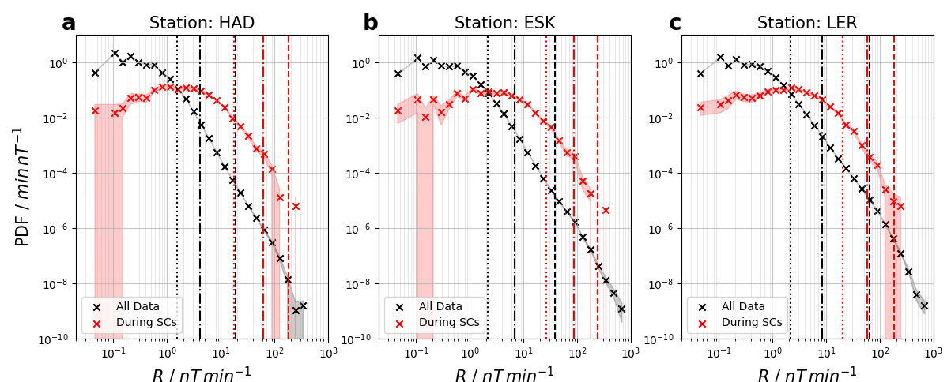
Progress & Outcomes: Sudden Commencements
Percentiles are largest at the middle (ESK) station – Theme 1?
PDFs intersect at around the 90th percentile (~1nTmin⁻¹)
90th, 99th and 99.97th percentiles marked
Increasing Latitude

Slide 7
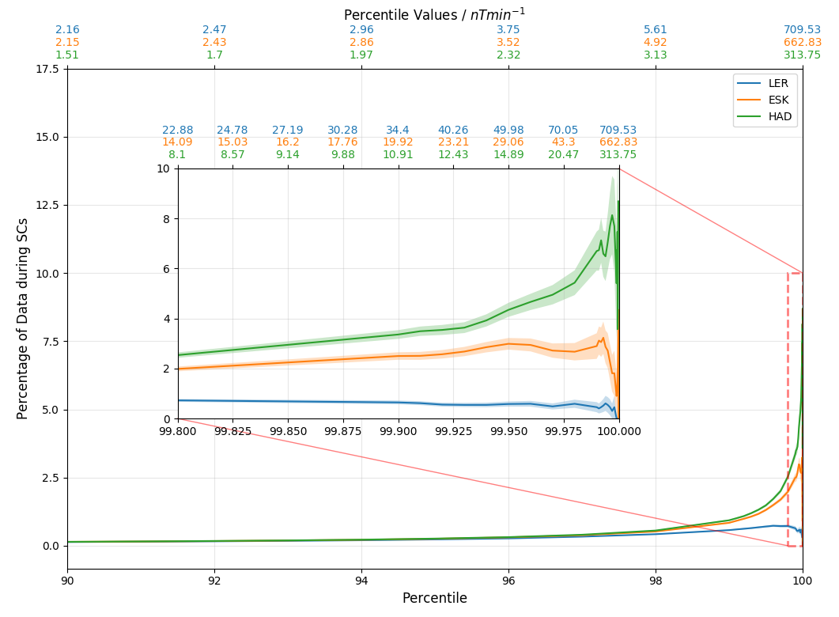
Progress & Outcomes: Sudden Commencements
We can evaluate the fraction of R that is attributable to SCs.
May expect that SCs are responsible for a greater fraction of large R at lower latitudes.
Total data: 11x10⁶ minutes
SCs: 1900 minutes
Overall Fraction = 0.0002%
However, above the very high percentiles this fraction become non-negligible.

Slide 8
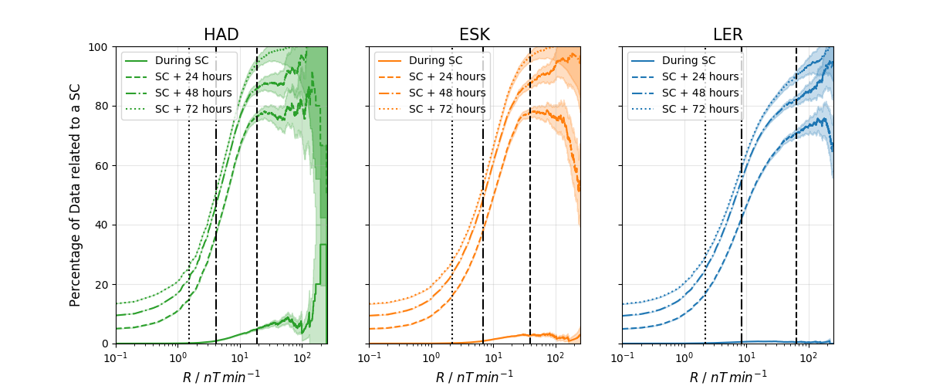
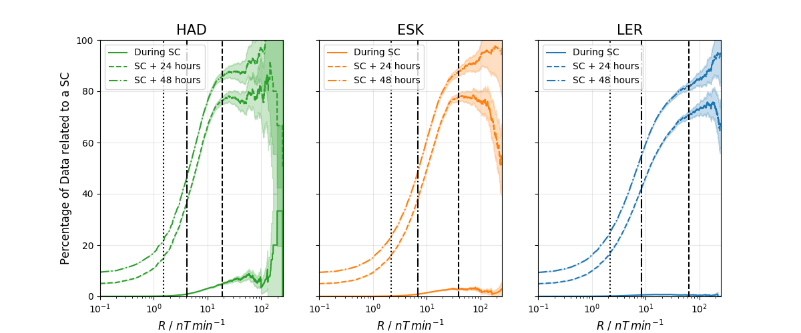
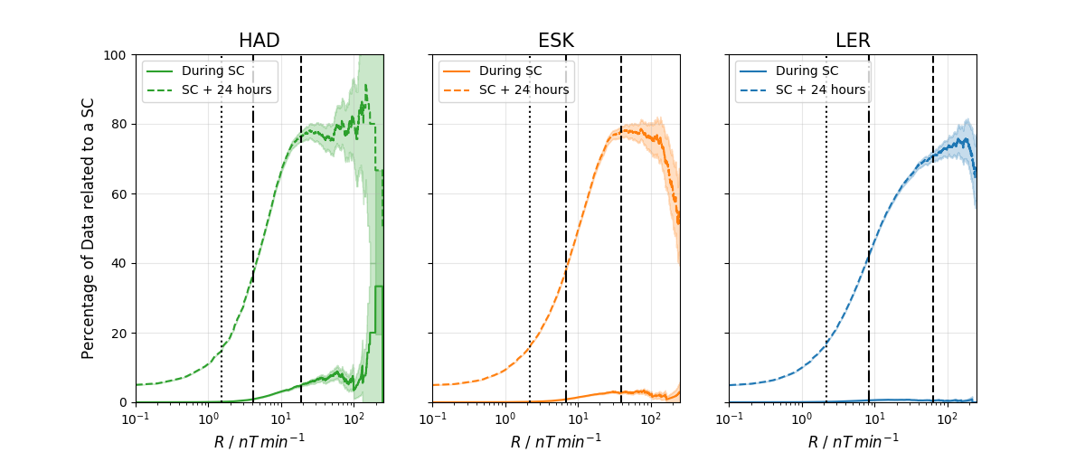
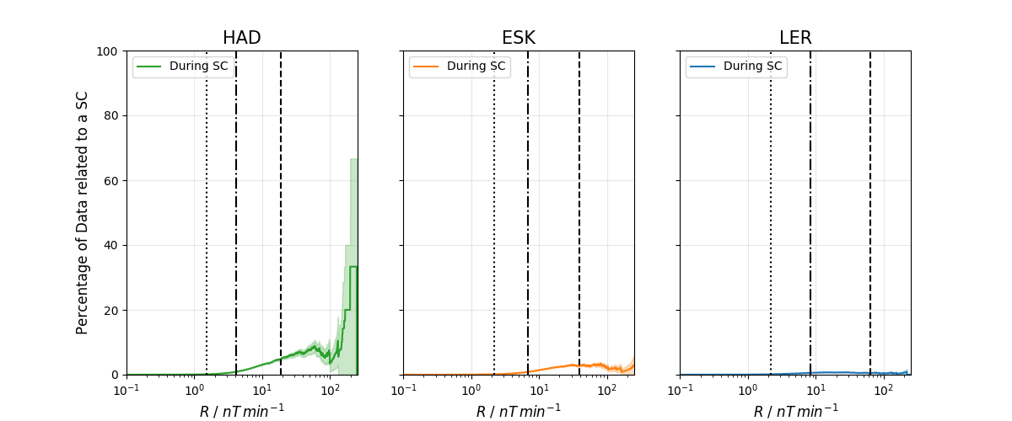
Progress & Outcomes: Sudden Commencements
90% of data above the 99.97th percentile occurs within three days of a SC.
All R > 200 nTmin⁻¹ occur within three days of an SC

Slide 9
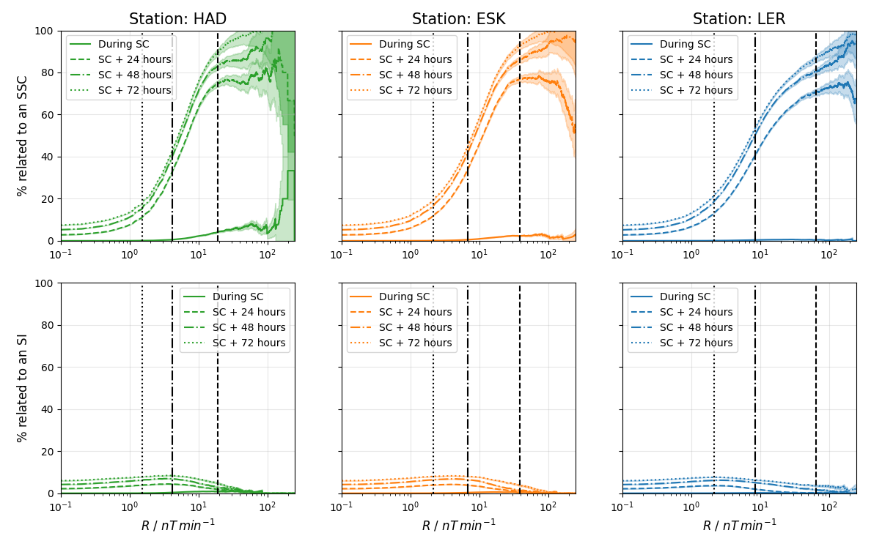
Progress & Outcomes: Sudden Commencements
If followed by a magnetospheric storm the SC is classified as a Storm Sudden Commencement (SSC).
If not, then it can be classified as a Sudden Impulse (SI)

Slide 10
Progress & Outcomes: Sudden Commencements
Rate of change of the surface magnetic field (R) in the UK is enhanced during SCs.
The percentiles of R are largest at the middle station (latitudinally).
Only small fraction of the largest R is attributable to SCs (< 8%).
Greater than 90% of extreme R occurs within three days of an SC.
Only SSCs lead to this enhancement, SIs have smaller impacts both initially and in the following days.
If you can forecast SCs (e.g. using heliospheric tracking from L5, or identified at L1) then you can predict the three day intervals in which the UK is likely to see the largest R.

Slide 11
What’s next?
Future research plans:
What are the magnetospheric conditions during observations of large R in the UK?
Can we predict whether a SC is to lead to a geomagnetic storm?
OMNI data often poorly resolves large changes in dynamic pressure that cause SCs. Can we decompose the signature of a SC to back-calculate the size of the dynamic pressure change?

Slide 12
Future collaboration with other WPs
What are the magnetospheric conditions during observations of large R in the UK?
Will highlight the conditions under which large R is observed, potential collaboration with WP 3.2
Can we predict whether a SC is to lead to a geomagnetic storm?
Will find the variables that best aid this prediction, possible collaboration with WP 3.2
OMNI data often poorly resolves large changes in dynamic pressure that cause SCs. Can we decompose the signature of a SC to back-calculate the size of the dynamic pressure change?
Potentially of use with historical ground based records, where only ground observations are available, potential collaboration with WP 3.2.2

Slide 13
Upcoming Meetings
Machine Learning in Heliophysics (16 – 20th September 2019):
Preliminary results for the future re. forecasting large R will be presented [Smith].
European Space Weather Week (18th – 22nd November 2019):
Sudden Commencement study, as well as some of the future work will be presented [Smith, Rae].

