Slide 1
The importance of geoelectric fields
Specifying the natural environment risk for GIC
Notes:
I’ve used the RAL Space template because I just adapted from my September 2018 SWIGS meeting slides, please change as needed

Slide 2
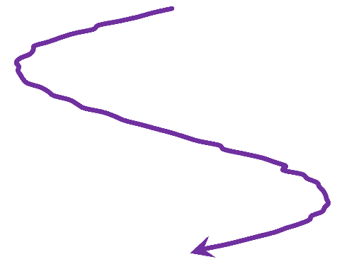
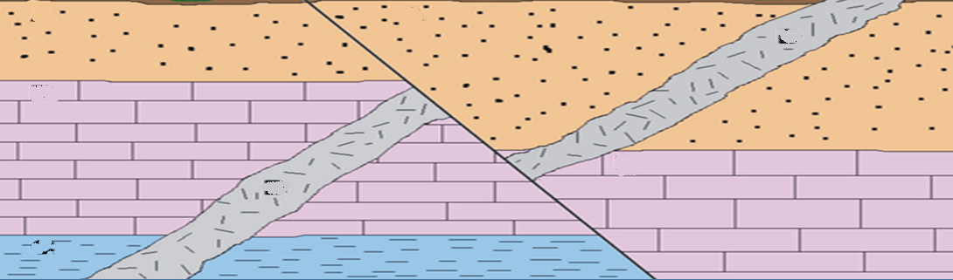
Three elements of GIC
dB/dt from space weather: electrojets, sudden impulses, ring current, pulsations?
Risk scenarios (“benchmarks” in US) need parameters that reflect extreme conditions in the natural space weather environment: key science input to policy
Which element is best to provide this?
Conducting networks experience induced voltages that drive GIC, following Kirchoff’s Law
E_{geo}
Induced geoelectric fields, deep into conducting Earth

Slide 3
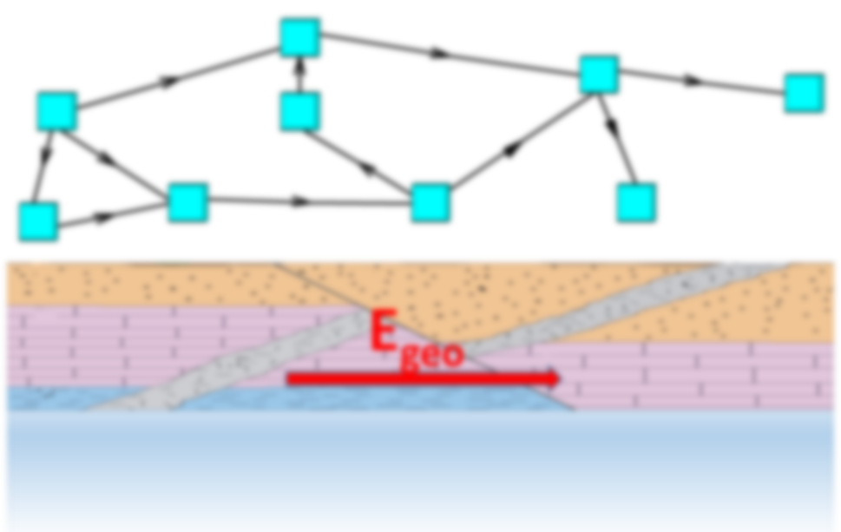
dB/dt: the old way?
As used in 2012 UK reasonable worst case (5000 nT/min)
Nat Risk Assessment, RAEng report
Nat Grid correlation reported by Erinmez (2002)
State-of-art in 2012
Widely used since 1989 storm
Advance wrt Kp
Wide data availability
Values from Thomson et al (2011), & Kappenman (2006)

Slide 4
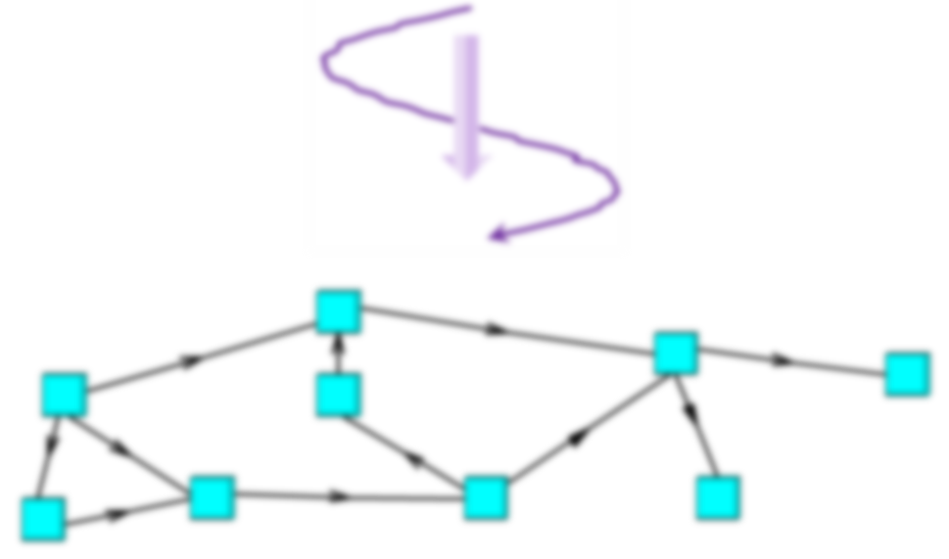
Moving to E-fields?
2018 UK reasonable worst case noted that Egeo is also relevant
Alongside dB/dt
>20 V/km (Beggan et al, 2013)
International state-of-art moving to Egeo
Prime driver of GIC
Better reflects vector nature of dB/dt and Egeo
Coastal effects
MT data more widely available
E_{geo}

Slide 5
Some questions: 1
Does use of geoelectric fields give more insight into regional variations of GIC risk?
  Do averages obscure critical detail?
  Coastal effects, especially E-fields “parallel” to coast
Does the UK need to keep up with the international state-of-the-art?
Can we improve the historical evidence base for large geoelectric fields in the UK?
  Telecomms records from storms such as May 1921 and Nov 1960?

Slide 6
Some questions: 2
How does this fit with current UK capabilities as being developed via SWIGS?
  Promote
How do we communicate the changing state-of-the-art to a wider UK audience?
How does grid evolution affect GIC risk?
  See next slide

Slide 7
Grid evolution
More HVDC interconnects (see map, next slide):
  more technical control?
  more risk from distant impacts?
Low carbon generation
  less intrinsic inertia (“spinning mass”) in system
  more sensitive to short-term (seconds) anomalies (see 9 August slide)
  Needs alternative technologies (e.g. battery backup, as 9 August)

Slide 8
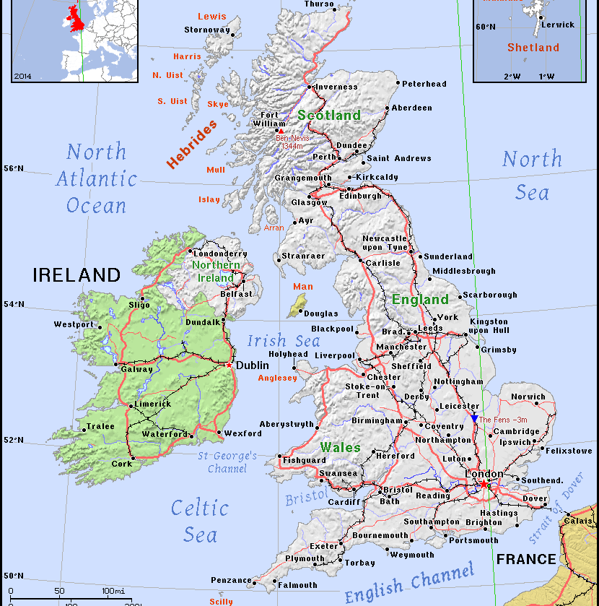
UK interconnects today
International:
France
Netherlands
R. Ireland
Belgium
Norway
More in planning
Internal
Scotld-Wales
Moray Firth

Slide 9
9 August 2019
90 secs
From Ngrid ESO interim report

