Slide 1
Update on rail anomaly analysis
mike.hapgood@stfc.ac.uk

Slide 2
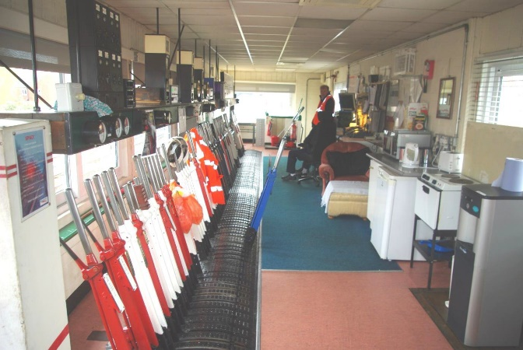
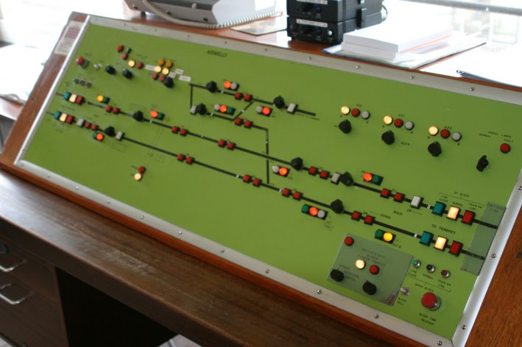
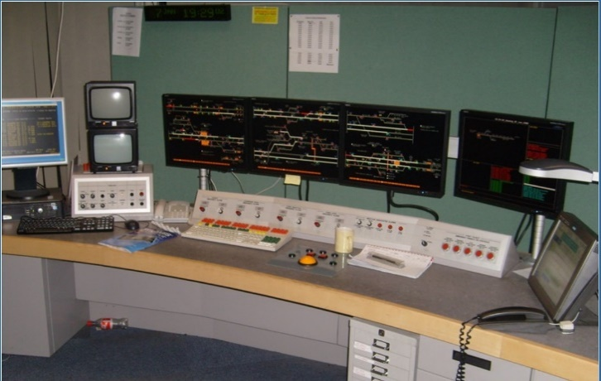
Understanding the technology
UK rail control systems are diverse as in dated images below, reflecting different regional histories, and investment patterns
Many middle-rank lines use legacy systems: signal boxes control track blocks via inter-box comms and track circuits (left)
Gradual modernisation with 1960s electronic panels (centre)
Major lines have intensive infrastructure (incl. track circuits) controlled remotely by a few centres (modern desktop - right)
Limited infrastructure on remote lines: mobile/landline phones
2016
2008
2005
Notes:
And here is the diversity of technologies. Left image is Abbey Foregate signal box in Shrewsbury taken on 9 April 2016, note the modern appliances on right of picture: water cooler, microwave oven, modern electric kettle on power base plate. The middle image is a 1960s style panel at Kidwelly, taken on 7 April 2005, so is likely the panel for which buzzing noises were noted. The right image is a modern computerised control at Port Talbot, taken 6 January 2008.

Slide 3
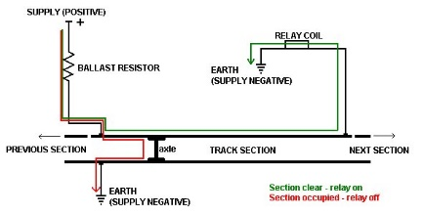
What is GIC risk to rail?
Rail uses range of grounded technologies that provide extended conductive paths along tracks
Track circuits - central to rail safety since 1870s – see figure
Control lines for colour light signals
Legacy comms lines for block control, bell signals
Notes:
Maybe briefly outline the vulnerabilities, especially track circuits. It’s perhaps worth adding that these systems generally use low currents (tens of milliamps is my understanding) so can be disrupted by modest GIC levels. For example a modern control cable with 0.9mm diameter copper wire has resistance of 28 ohms per km, so a 2 V km-1 geoelectric field can drive up to 73 mA of GIC (depending on other resistances in the system).

Slide 4
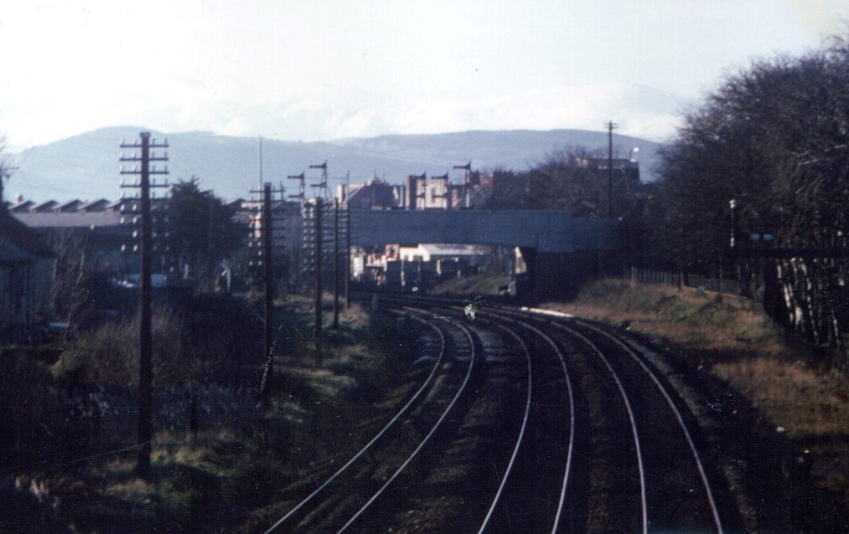
Low currents & relays
Long electrical connections on rail systems generally use low currents (~10s mA) so modest GIC levels can disrupt
Relays activate local power for devices such as signals and bells
Even with modern cables (~0.9mm ø Cu) a 2 V/km geoelectric field can drive up to 73 mA of GIC
Older cables heavier (~2.8mm ø Cu = x10) so they could run overhead (see image). GIC up x10.
Latter cables similar to telegraph lines used in early 20th century (9 gauge Cu)
1976 – overhead line posts & semaphores

Slide 5
Anomaly studies
Reprise from 2018
Two sets of anomaly reports courtesy of Network Rail
All GB for Mar 2015 & Sep 2017 storms
Wales & Marches for storms in 2003, 2004 and 2005.
Initial analysis suggestive of a correlation between dH/dt and anomalies in track circuits and signalling system
Recent work
Case study on October 2003 anomalies – following slides
Consolidated reports & HAD/ESK into spreadsheet tool, enabling
More systematic identification of dH/dt cases
Test against range of thresholds
But case studies show we need to treat dH/dt as vector
Next step is to update tool
Notes:
Added Jim’s text. Should “exploiting” be “exploring”?

Slide 6
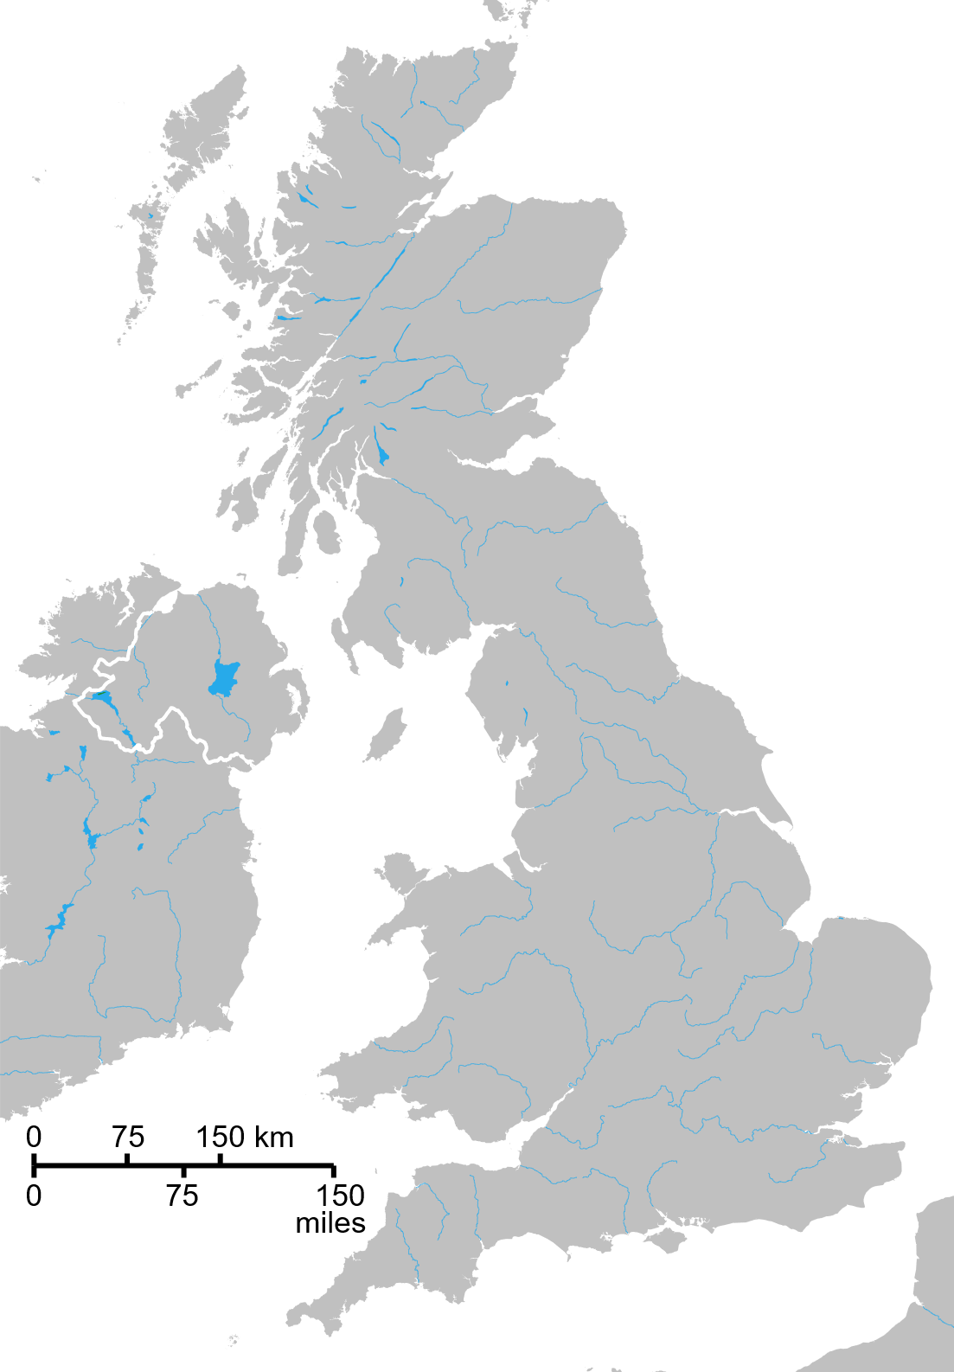
Case study: 30 Oct 2003
Carmarthen
30 Oct 2003, 20:05 onwards, From Kidwelly SB, having problem with panel making buzzing noise & Bell spuriously ringing
Ferryside
Kidwelly
also affecting Ferryside & Carmarthen. Problems cleared by 03:00 next day
Pembrey
30 Oct 2003, similar problems in Cornwall. Anomaly reports blame solar flares & “atmospherics”
Notes:
Animated map of affected area – first showing location in UK, and then adding a summary of the anomaly on the line through Kidwelly to Carmarthen. Also included note on problems in Cornwall – as noted in the Kidwelly anomaly report. We have, so far, been unable to find more information on the problems in Cornwall, not least the locations.

Slide 7
Historical comparison
Rail anomaly report from Halloween storm 2003 From Kidwelly SB, having problem with panel making buzzing noise & Bell spuriously ringing also effecting Ferryside & Carmarthen.
Walter Maunder describing the November 1882 storm The needles in the telegraph instruments twitched to and fro. The signal bells on many of the railway lines were rung, and some of the operators received shocks from their instruments.
Notes:
Comparing the 2003 anomaly report with some text on the impact of the large geomagnetic storm in November 1882 as reported by Walter Maunder in his 1900 book: “The Royal Observatory Greenwich: a glance at its history and work”. It strikes me that there is some reasonable similarity, especially in respect of the use of bells for communications between signal boxes, and the possible impact of GIC on those bells. It gives me some confidence that the 2003 anomaly really was caused by GIC. (NB I am working to better understand the technical use of bells and how that use may have changed.)

Slide 8
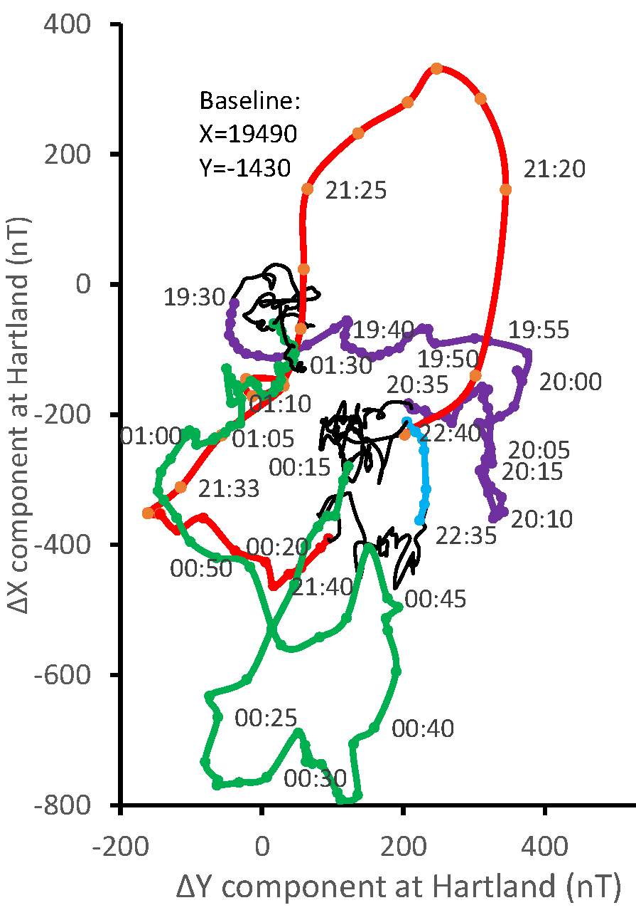
Geomagnetic effects
30/31 October 2003: 18:00 – 02:00
Data from Hartland
83 km S of Kidwelly
Plot shows XY changes after baseline removal
Rapid changes:
19:30 to 20:30 (purple)
21:15 to 21:40 (red)
22:35 to 22:40 (cyan)
00:15 to 01:30 (green)
Similar to Hartland changes at peaks of 1989 storm (next slide)
Small changes (black):
66% of data in plot
Notes:
Hodogram showing changes in X and Y at Hartland on night of 30-31 October 2003. Baseline estimated by eye from Intermagnet daily XYZ plots for 23-28 October, quiet-ish days preceding the Halloween storm. Given that Kidwelly and Hartland are < 100 km part, Hartland is a good monitor of the conditions at Kidwelly. The hodogram shows that there were large excursions in both X and Y at various times from 19:30 through to 01:30 – which coincides well with the reports of problems from 20:05 onwards through that night. These excursions are similar but slightly smaller than the excursions seen at Hartland during the 1989 storm, ones that produced significant GIC effects on UK National Grid (next slide).

Slide 9
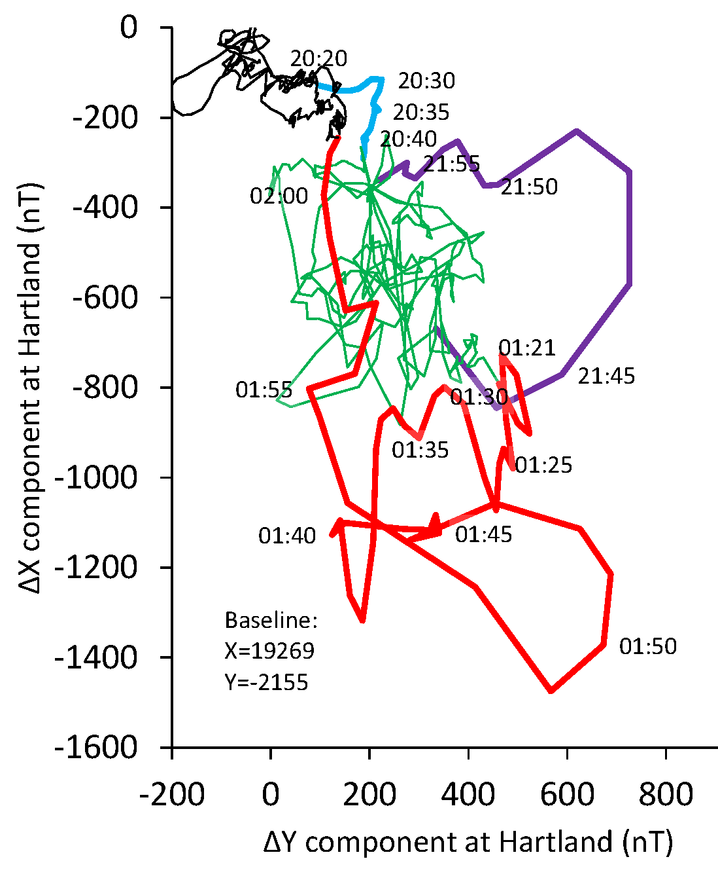
Comparison with 1989
13/14 March 1989: 18:00 – 05:00
Transformer alarms at
Norwich 21:34 & 01:27
Indian Queens 01:52
Data from Hartland
434 km west of Norwich
73 km NE of Indian Queens
Plot shows XY changes after baseline removal
Large changes (green) with major excursions at:
21:40 to 22:00 (purple)
01:20 to 02:00 (red)
Close to alarm times above
Notes:
Hodogram showing changes in X and Y at Hartland on night of 13-14 March 1989. Baseline taken as annual mean from 1989 Yearbook. The hodogram shows that there were large fluctuations in X and Y through the night, mostly in the range X=-600±200 nT and Y=200±200 nT (green), which suggests a fluctuating westward electrojet nearby. Two large excursions in both X and Y occurred at 21:30 to 22:00 and at 01:20 to 02:00, suggesting a more complex (vortex?) current pattern was present. The first excursion matched observations of intense aurora over Southern England by MH. The second excursion is a good match to the GIC-induced transformer alarm at Indian Queens, close to Hartland. The alarms at Norwich seem to precede the excursions at Hartland, perhaps indicating the current pattern was propagating westward. This event also caused excessive transformer noise at Pembroke, 84 km north-west of Hartland, but no times are available. Nonetheless the 1989 event provides good evidence of GIC impacts being associated with large XY excursions at Hartland.

Slide 10
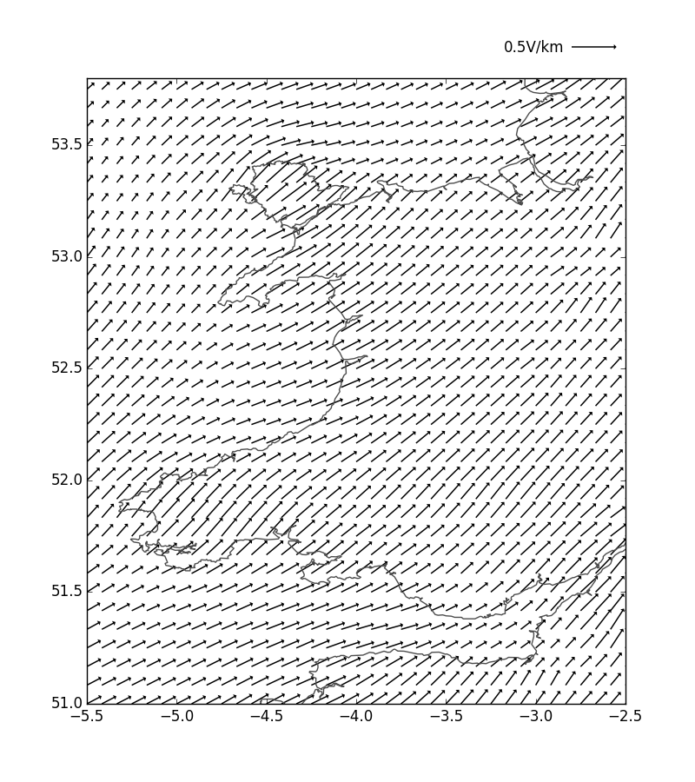
E-field modelling
Plot shows modelled E-fields @ 21:20
uses data from Hartland (●) & other observatories
Significant E-fields present at time of reported anomaly
anomaly may well be result of SpW
Notes:
Alan – is this what you were suggesting?
Note animation to highlight location of Kidwelly

