Slide 1
Summary of activities:
10 month, no-cost extension approved by NERC, followed by a new PDRA appointed for 2 years
Publication of a new book flagged in Researchfish: Ionospheric multi-spacecraft tools (methods involving Swarm, AMPERE and ground based data)
ESA approved, Swarm DISC proposal to estimate FAC orientations from two spacecraft cross-correlations of Swarm data: context from corresponding auroral boundaries
New study of corresponding MLT dependence of FAC and dH/dt distributions for storm and sub-storm phases
New study of conjunctions of Cluster and Swarm, mapped onto the AMPERE model FACs, to show corresponding signatures
New study coordinating Cluster-Swarm-superMAG data for a close conjunction of a sub-storm driven BBF event
Anticipate to now proceed with a number of activities:
  Analysis of variances (histograms) of current sheet alignments (MLT,MLAT bins)
  FAC scaling and coherence for conjunction events (e.g. Cluster/Swarm/AMPERE coordination)
  Dependencies of the distributions of (large and small) FACs and GIC signatures for high geomagnetic activity
  Ionospheric signatures of FACs carried by electrons from the inner boundary layer (LLBL and HLBL)

Slide 2
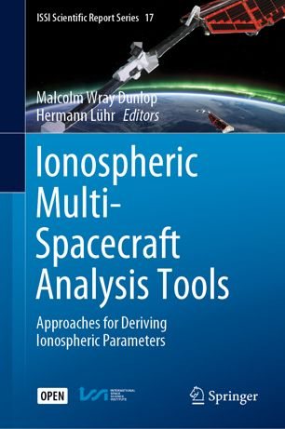
Science exploitation:
New development of analysis tools; based on Swarm/AMPERE/superMAG
New open access Springer e-book
Editors: M Dunlop and H Luehr
(https://link.springer.com/book/10.1007/978-3-030-26732-2#about)
Citation: Dunlop, M. W. and H. Luhr (eds), ISSI scientific reports volume 17, Springer, DOI:10.1007/978-3-030-26732-2, 2020
Article for the associated working group, published in the ISSI bulletin: http://www.issibern.ch/publications/pdf/ar/ar21.pdf
Individual papers:
Dunlop, M. W. and H. Luhr, Introduction, ISSI scientific reports volume 17, Springer, DOI:10.1007/978-3-030-26732-2_1.
Dunlop, M. W. J.-Y. Yang, Y-Y. Yang, H. Lühr and J.-B. Cao (2019), Multi-spacecraft current estimates at Swarm, in Multi-satellite data analysis, ISSI scientific reports volume 17, Springer, DOI:10.1007/978-3-030-26732-2_5.
Trenchi, L., et al. (inc Dunlop) (2019), ESA field-aligned currents – methodology inter-comparison exercise, in Multi-Spacecraft analysis tools, ionosphere, ISSI scientific reports volume 17, Springer, DOI:10.1007/978-3-030-26732-2_8

Slide 3
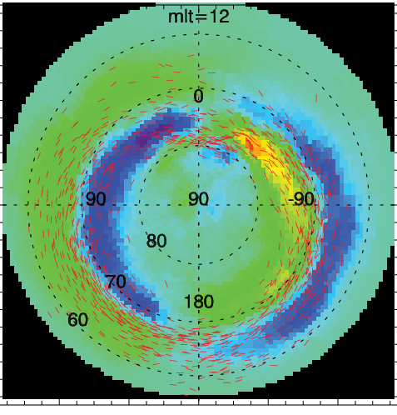
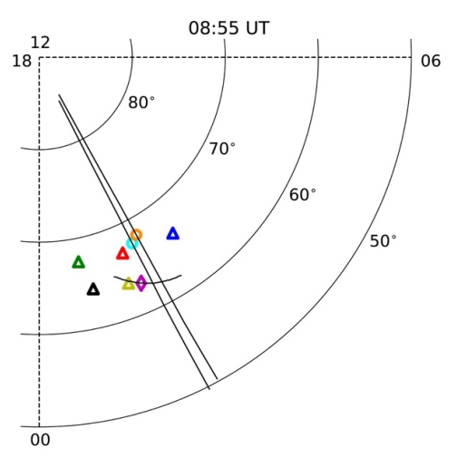
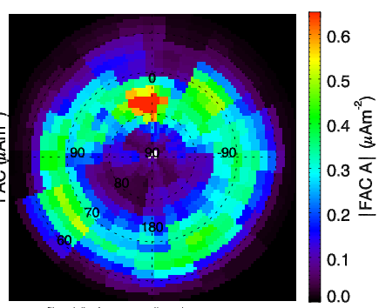
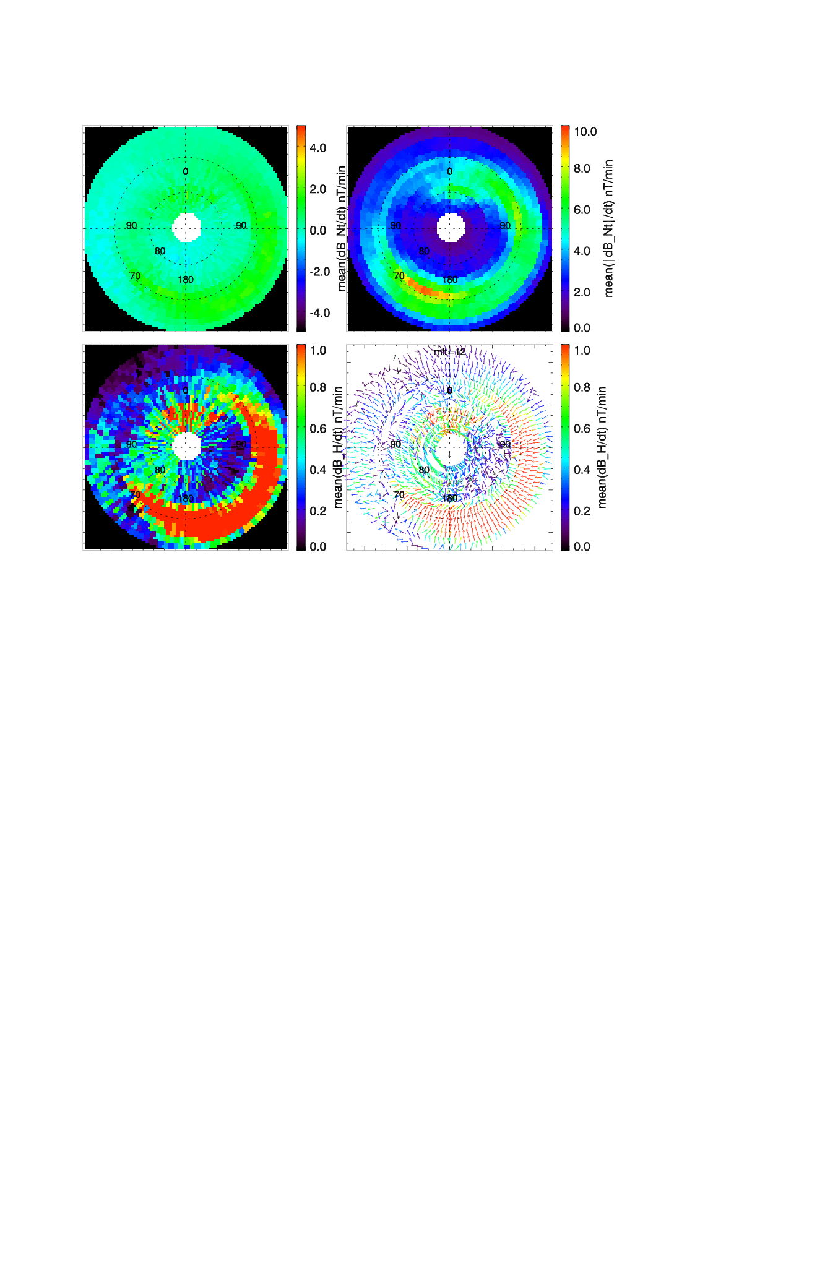
Future studies:
New DISC idea (successful): on FAC-GIC coupling tools (multi-spacecraft)
Space weather links: ESA SUA study (dB/dt, PEJ index)
Current sheet orientations (two satellite cross-correlations); on FAC distribution observed by Swarm
[Yang, Dunlop, et al. (2018), DOI: 0.1029/2018JA025205]
Current sheets show clear alignment to auroral boundaries (fluctuations driven by geomagnetic activity)
Individual conjunctions: FACs to GIC (dH/dt)
Cluster/Swarm FAC comparison to AMPERE model.
Mapping of Cluster FACs to AMPERE altitudes shows similar (filtered) signatures
Swarm provides rapid scan of latitude
Below: distribution of FACs from Swarm (left) and dH/dt (right) from SuperMAG for recovery phase, storm time conditions.
Shows similarities/differences at different MLT

Slide 4
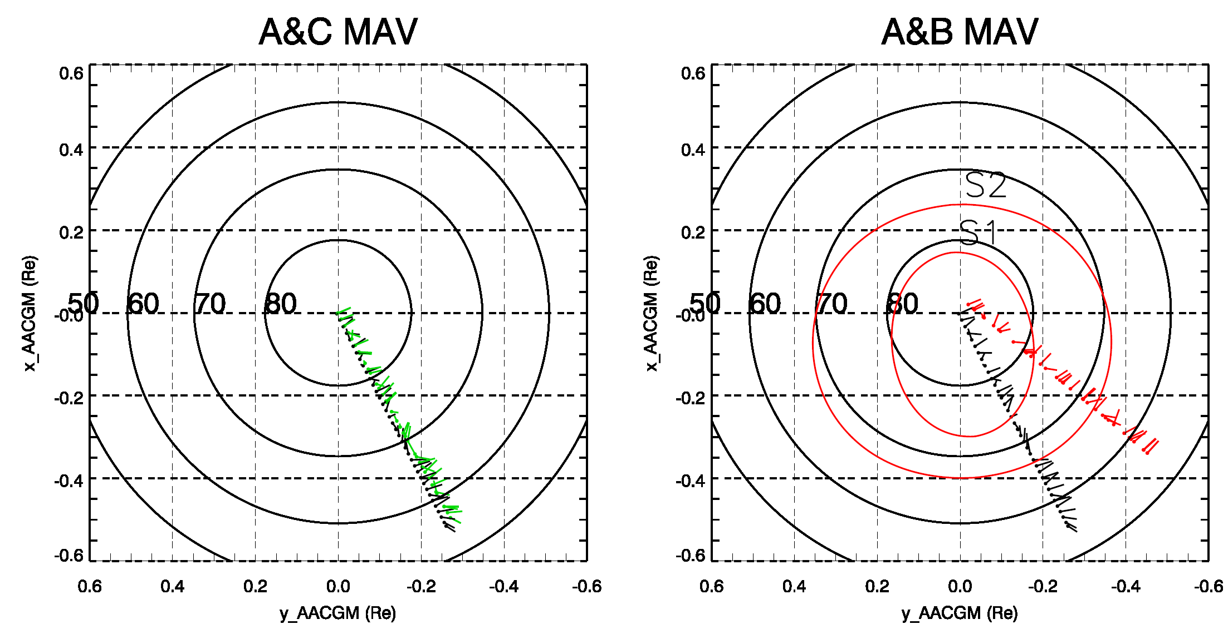
Individual conjunctions I:
FACs to GIC (dH/dt)
New study coordinating Cluster-Swarm-superMAG data
Close conjunction (location and timing): sub-storm driven BBF Cluster and Swarm see corresponding onsets of FACs
SuperMAG ground stations see corresponding, developing signatures across the Swarm and Cluster footprints.
ULF wave signatures can also be traced
FAC orientations
Notes:
Chao’s model can be added to the polar map.

Slide 5
Individual conjunctions II:
Scaling of FACs from Cluster to AMPERE and Swarm
Swarm period: blue 04:04:52-04:07:20
Cluster period: 03:12:51-06:37:51

Slide 6
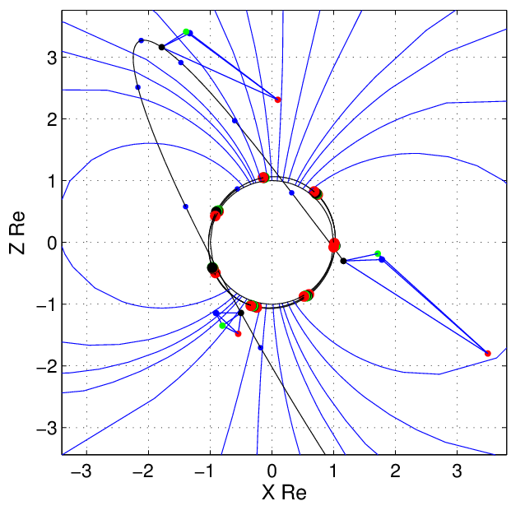
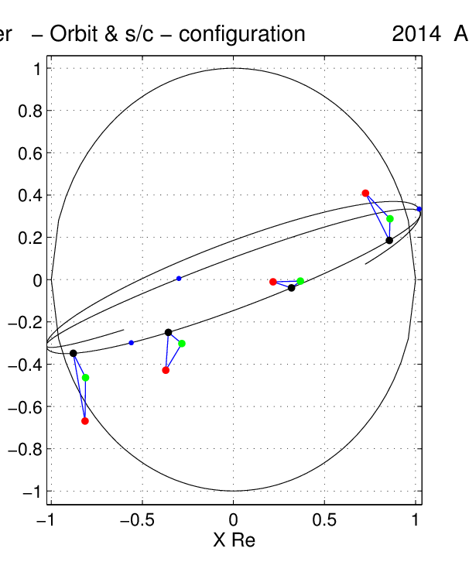
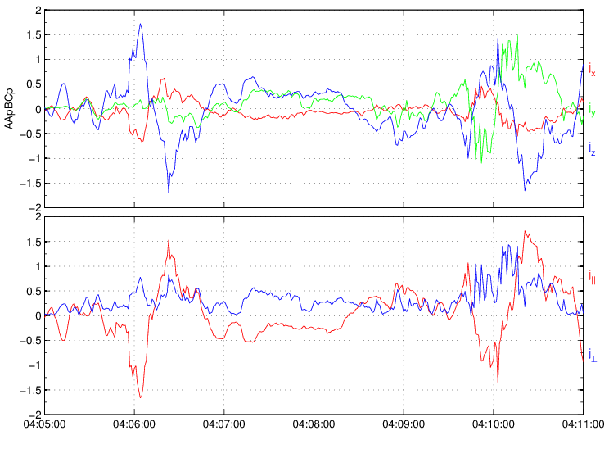
Previous Swarm analysis:
Development of curlometer for 2 and 3 spacecraft
Unique multi-spacecraft database in a key region
Swarm:
FAC
A
A’
C
Cluster
B
Swarm
Ring Current
Earth
First direct measure of field-aligned currents (FACs) at low orbit (magnetosphere to ionosphere coupling)
Current signatures at Swarm echoed in 4-spacecraft Cluster data when multi-spacecraft estimates are applied: coherent structures at different altitudes
Striking similarities at vastly different locations demonstrated for the first time (FAC scaling)
Cluster
Jx, Jy, Jz
New timing analysis based on the curlometer method
[Dunlop, Geophys. Res. Letts. DOI: 10.1002/2015GL063738;
Dunlop, Geophys. Res. Letts. DOI: 10.1002/2015JA021707]
All components of electric current density can be found
Notes:
The three Swarm spacecraft were launched on 22 November 2013
The slide shows a combined plot of Cluster and Swarm. Model field lines are drawn with the Sun on the right. The view is from the dawnside of the Earth.
The Cluster orbit moves from the front to just behind the Earth. Configurations of Cluster (4 spacecraft) are scaled (enlarged) by a factor of 3. Cluster moves from the magnetic equator to high inclination (marked FAC), where it sees field aligned currents, before falling again through the ring current.
The Swarm 3-spaceraft configuration is in formation, showing adjacent spacecraft positions (time shifted positions of spacecraft A and C (A'C') )
Not only does this give a more accurate (complete) estimate of FACs, but it also gives the perpendicular current components directly for the first time. These are representative of the associated Hall currents.

