Slide 1
Space Weather Impact on Ground-Based Systems
A 4-year UK Natural Environment Research Council grant-funded project, under the ‘Highlight Topics’ stream
10 partner institutes
BGS, BAS, RAL, Universities of Edinburgh, Lancaster, Leeds, Reading, Southampton, Imperial College London, University College London
21 researchers
6 new post-doc researchers
1st May 2017 - 2021
£3.75M (€4.20M)

Slide 2
Space Weather Impact on Ground-Based Systems

Slide 3
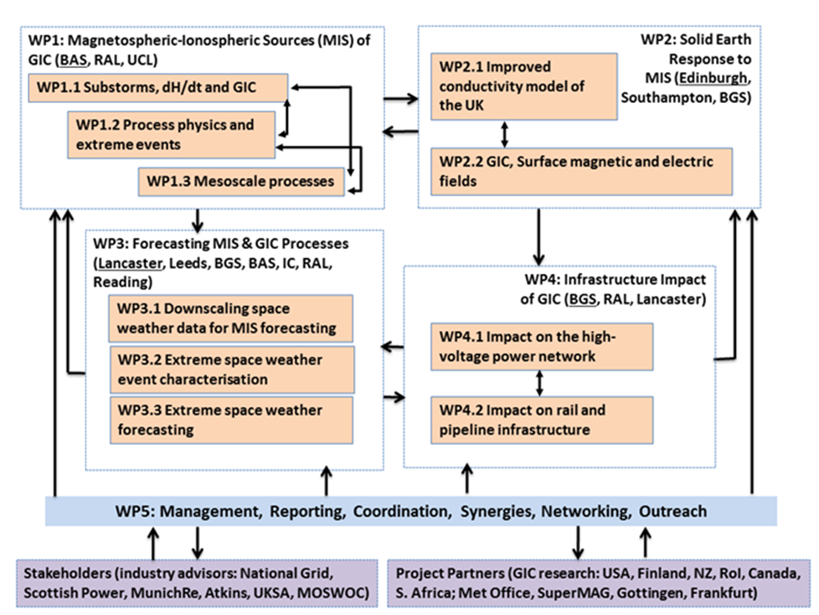
Space Weather Impact on Ground-Based Systems

Slide 4
Space Weather Impact on Ground-Based Systems
Day 1
12:00 – 13:00 Arrival and lunch
13:00 – 13:15 Welcome, local information and round-table introductions
(Alan Thomson, Jim Wild, All)
13:15 – 15:00 Session 1: WP1 (Chair: Neil Rogers)
13:15 – 13:20 Introduction – Reminder of aims, scope and timeline of WP1 (Mervyn Freeman)
13:20 – 13:40 Task 1.1.1 Substorms, rapid variations & GIC (Mervyn Freeman)
Task 1.2.3 Extreme current modes (Mervyn Freeman)
13:40 – 14:00 Task 1.2.1 Extremes, non-linearity and saturation (Yulia Bogdanova)
Task 1.2.2 Current system morphology and extremes
14:00 – 14:20 Task 1.3.1 Large and small scale current structures (Malcolm Dunlop)
14:20 – 14:40 Task 1.3.2 Ionospheric electric field variability (Mervyn Freeman for Andrew Kavanagh)
14:40 – 15:00 Task 1.3.3 Scale-size and GIC (Mark Clilverd)
15:00 – 15:30 Coffee break & discussion

Slide 5
Space Weather Impact on Ground-Based Systems
15:30 – 16:45 Session 2: WP4 (Chair: Ciaran Beggan)
15:30 – 15:40 Introduction – Reminder of aims, scope and timeline of WP4 (Ciaran Beggan)
15:40 – 16:00 Task 4.1.1 ‘Next generation’ grid model (Gemma Richardson, Ciaran Beggan, Juliane Huebert)
Task 4.1.2 Scale-size (not started, brief reminder only)
Task 4.1.3 Verification and validation (Gemma Richardson, Ciaran Beggan, Juliane Huebert)
16:00 – 16:05 Task 4.1.4 Dissolved Gas Analysis (Jim Wild)
16:05 – 16:25 Task 4.2.1 Anomaly Correlation (Mike Hapgood)
Task 4.2.2 Railway Network (Mike Hapgood)
16:25 – 16:45 Task 4.2.3 Pipelines (Gemma Richardson/Alan Thomson)
16:45 – 17:00 General Discussion
17:00 Close of Day 1
19:30 Dinner
QSF, 27a St Georges Quay Lancaster LA1 1RD, 01524 843 199

Slide 6
Space Weather Impact on Ground-Based Systems
Day 2
09:15 – 10:45 Session 3: WP3 (Chair: Juliane Huebert)
09:15 – 09:20 Introduction – Reminder of aims, scope and timeline of WP3 (Jim Wild)
09:25 – 09:40 Task 3.1.1 Develop methodologies to effectively downscale magnetospheric model outputs to temporal/spatial scales required for GIC response models (Mike Lockwood)
09:40 – 10:00 Task 3.2.1 Quantify the potential impact of extreme GICs on electricity infrastructure (Neil Rogers)
10:00 – 10:20 Task 3.2.2 Extend GIC climatology to 150 years (Mike Lockwood)
10:20 – 10:40 Task 3.3.1 Determine the effect of internal field change on GIC intensity and occurrence (Lars Mejnertsen)
10:40 – 10:45 Task 3.3.2 Determine plausible extreme displacements of the auroral oval and their impact on grounded infrastructure (Phil Livermore)
10:45 – 11:15 Coffee break & informal discussion

Slide 7
Space Weather Impact on Ground-Based Systems
11:15 – 12:35 Session 4: WP2 (Chair: Kathy Whaler)
11:15 – 11:25 Introduction – Reminder of aims, scope and timeline of WP2 (Kathy Whaler)
11:25 – 11:50 Task 2.1.1 Create new 3D conductivity data (Fiona Simpson)
11:50 – 12:10 Task 2.1.2 Re-evaluate/reprocess historic data (Kathy Whaler)
Task 2.1.3 Exploit data from existing assets (not started, brief reminder only)
Task 2.1.4 Estimate uncertainties (not started, brief reminder only)
12:10 – 12:35 Task 2.2.1 GIC measurements (Juliane Huebert/Ciaran Beggan)
Task 2.2.2 Electric and magnetic field measurement (not started, brief reminder only)
12:35 – 12:45 Short break leading to working lunch during Session 5
12:45 – 14:00 Session 5: Review and Discussion (Alan with support from Mervyn, Kathy, Jim and Ciaran)
14:00 End of workshop

Slide 8
Space Weather Impact on Ground-Based Systems
Session 5: Review and Discussion
General
Reflections: lessons learned from yesterday and today?
Your general plans for the future?
How does SWIGS relate to the ‘bigger picture’, e.g. how is the
space weather ‘landscape’ evolving since we started SWIGS?
Opportunities for cross-task & cross-WP research (actual, possible, planned)?
Your expected ‘impacts’ resulting from SWIGS (actual, future)?
Other?
Specific
Your data sharing and upcoming data and collaboration needs?
Project website and meetings/presentations/papers repository?
Your DMP?
Other related projects and programs that we can align with?
External meetings schedule?
Other?

Slide 9
Meetings, Conferences, Workshops
Happened
Lerwick Magnetic Observatory ‘Open Weekend’ – July 2017
European Space Weather Week – Nov 2017
Royal Astronomical Society Specialist Meeting– Mar 2018
European Geophysical Union – Apr 2018
IAGA Observatories Workshop – June 2018
IAGA Electromagnetic Induction Workshop – Aug 2018
Upcoming
European Space Weather Week – Nov 2018
American Geophysical Union – Dec 2018 (TBC)
Possible/Probable
European Geophysical Union – Apr 2019
International Union of Geodesy and Geophysics – Jul 2019
SWIGS-themed sessions at ?
…

Slide 10
Institute PI Meeting
Reflections on the meeting
How does this meeting affect your research plans now and in future?
Any activities elsewhere that influence your SWIGS work?
Scientific progress to date
On track?
Planned activities over next year and any changes to original plan
Budgets and project plans
Any deviations?
Staff
Issues, e.g. changes and timing of new starts
Data Management Plans
Updates?
Input to 6-monthly NERC reports
Via WP leaders, each October and April
Advisory Group feedback – will follow meeting
Perceived new or changing needs for …?
Other issues/ideas/comments?

