Slide 1
The influence of substorms on extreme rates of change of the surface magnetic field in the UK
and other latitudes
Mervyn Freeman, Robert Shore
British Antarctic Survey
Colin Forsyth, Jonathan Rae, Andy Smith
Mullard Space Science Lab., University College London
[Freeman et al., Space Weather, 2019]

Slide 2
Motivation
Electricity supply networks can be vulnerable to space weather
  Extreme rate of change R of geomagnetic field causes unwanted geomagnetically induced current (GIC)
Socio-economic study of UK GDP loss from 1-in-100 year event
  £16 billion* with no forecasting
  81% reduction to £3 billion with current forecasting
  Further 70% reduction to £0.9 billion with enhanced forecasting
  [Oughton et al., Risk Analysis, 2019]
Improved forecasting requires understanding of M-I current sources
  Oughton et al. [2019] economic losses based on different geomagnetic storm scenarios with 0, 1, or 2 intense substorms occurring when UK is in the 0-3 MLT sector
* ~ annual UK contribution to EU

Slide 3
Enhanced forecasting challenge
What actually causes potentially damaging R?
Substorm?
  Unpredictable timing and size of individual substorms
  [e.g., Morley et al., J. Atmos. Sol.-Terr. Phys, 2009]
  Statistics of recurrence and size can be modelled
  [Freeman and Morley, Geophys. Res. Lett., 2004;
  Morley et al., Ann. Geophys., 2007]

Slide 4
Substorm electrojet – DP1
S
[Shore et al., Space Weather, 2019]
N
17% DP1 variance explained by IMF Bz
[Shore et al., J. Geophys. Res., 2018]
Mean eigenmode over solar cycle 23 (1997-2009)

Slide 5
Enhanced forecasting challenge
What actually causes potentially damaging R?
Enhanced convection?
  Relatively predictable from IMF

Slide 6
Convection electrojet – DP2
S
[Shore et al., Space Weather, 2019]
34% DP2 variance explained by IMF Bz
N
[Shore et al., J. Geophys. Res., 2018]
Mean eigenmode over solar cycle 23 (1997-2009)

Slide 7
Enhanced forecasting challenge
Improved forecasting requires understanding of M-I current sources
  Oughton et al. [2019] economic losses based on geomagnetic storm scenarios with 0, 1, or 2 intense substorms occurring when UK is in the 0-3 MLT sector
What actually causes potentially damaging R?
Substorm?
  Unpredictable timing and size
Enhanced convection?
  Relatively predictable from IMF
Other? Sudden Commencements?
  SCs = ~5% of extreme R (>99.97th percentile) in UK
  [Smith et al., Space Weather, submitted, 2019]

Slide 8
Substorm v Convection
Which is more important for potentially damaging R?

Slide 9
SOPHIE [Forsyth et al., J. Geophys. Res., 2015]
SMU = northward ΔB / peak eastward equivalent current
SML = southward ΔB / peak westward equivalent current
Substorm electrojet – DP1
Convection electrojet – DP2
S
N
Substorm expansion => -dSML /dt > EPT
Enhanced convection => |dSML/dt| ~ dSMU/dt > EPT

Slide 10
SOPHIE results
1996-2014 (solar cycles 23 & 24)
Type | Number of intervals | Percentage of all time
Substorm expansion | 23,846 | 4.1% | } } 13.4% }
Substorm recovery | 24,075 | 9.3%
Enhanced convection | 6,208 | 1.7%
Other times | 24,312 | 84.8%
[Forsyth et al., J. Geophys. Res., 2015]

Slide 11
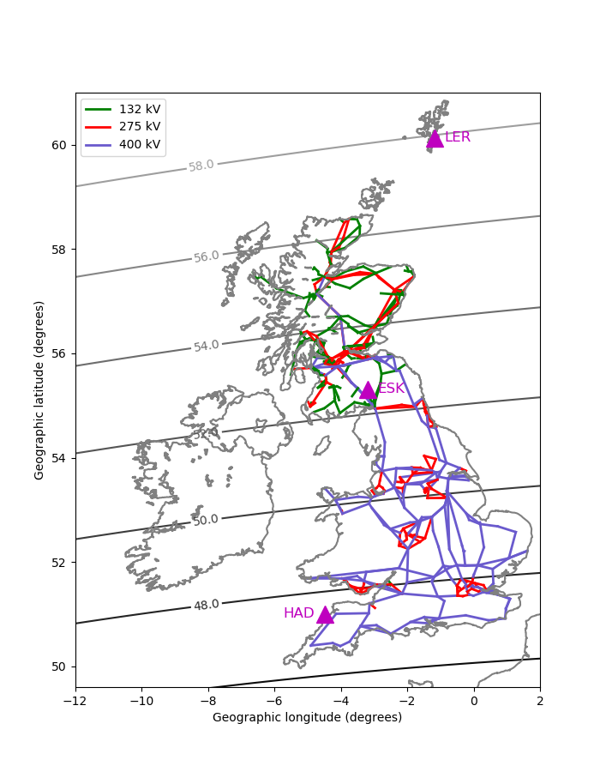
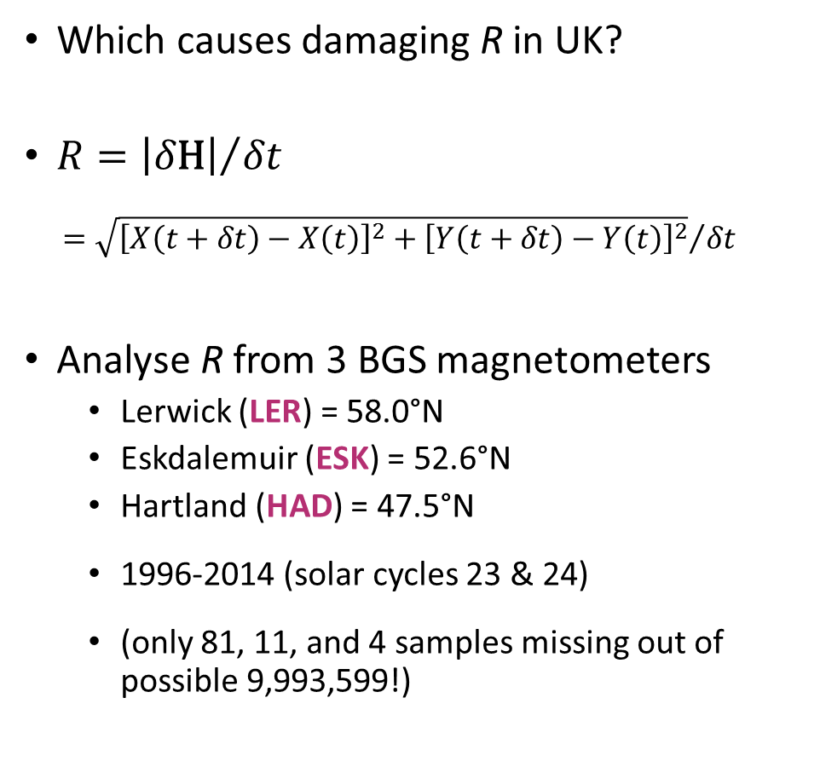
Substorm v Convection
Which causes damaging R in UK?
$R={\left|δ\text{H}\right|}/{δt}$
$={\sqrt{{\left[X\left(t+δt\right)−X\left(t\right)\right]}^{2}+{\left[Y\left(t+δt\right)−Y\left(t\right)\right]}^{2}}}/{δt}$
Analyse R from 3 BGS magnetometers
  Lerwick (LER) = 58.0°N
  Eskdalemuir (ESK) = 52.6°N
  Hartland (HAD) = 47.5°N
  1996-2014 (solar cycles 23 & 24)
  (only 81, 11, and 4 samples missing out of possible 9,993,599!)

Slide 12
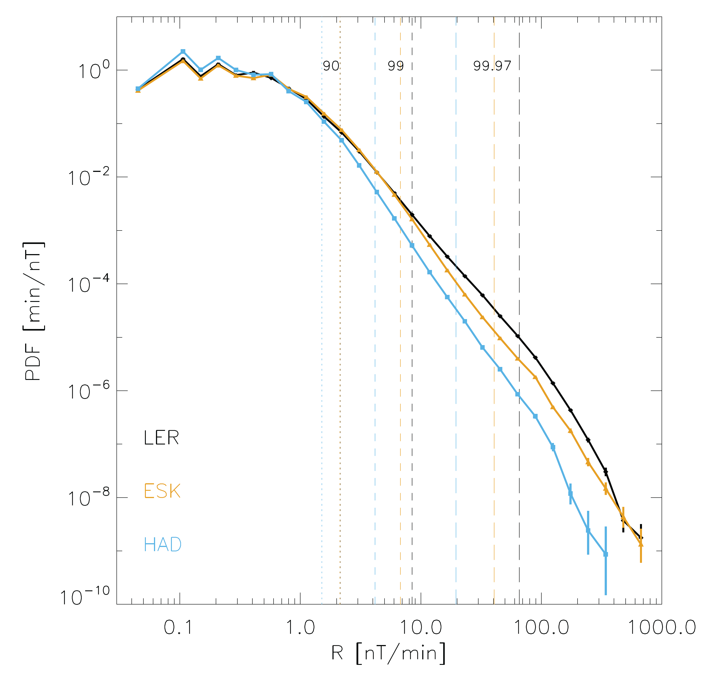
PDFs
Damaging R: >600 nT/min
  ~ 40 A GIC [Thomson et al. 2005]
  Only 4, 2, 0 samples
  at LER, ESK, HAD
Extreme R: >99.97th percentile
  20-70 nT/min
  3,000 samples
Large R: >99th percentile
  4-9 nT/min
  100,000 samples
Looking for trends

Slide 13
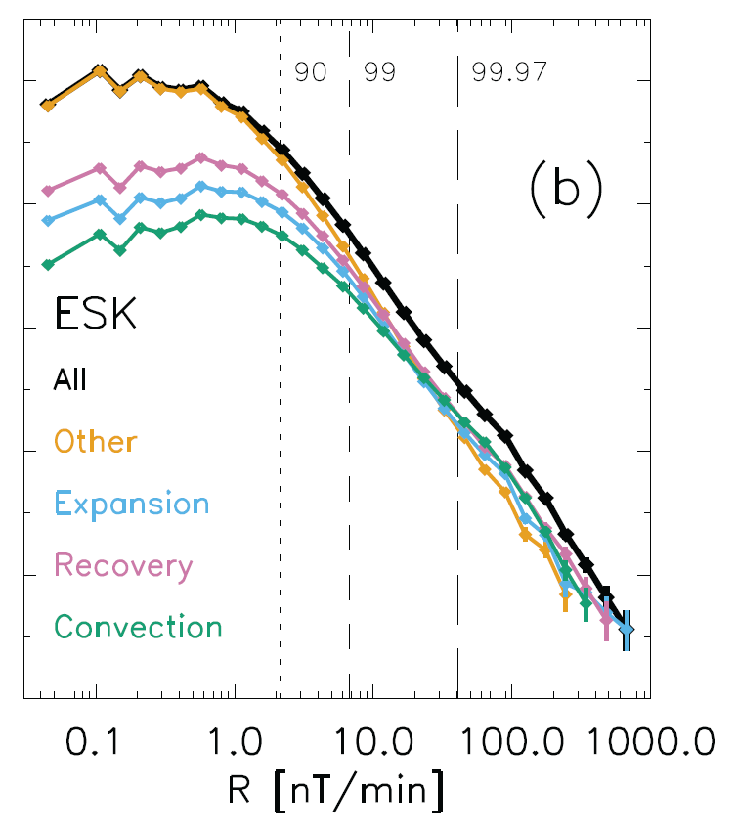
Results 1
Extreme R mostly occurs
during substorms
PDF of extreme R (≥ 99.97 %ile) at ESK
Extreme R more common
during substorm expansion
and recovery phases
and during enhanced convection
than during other times

Slide 14
Results 1
Extreme R mostly occurs
during substorms
PDF of extreme R (≥ 99.97 %ile) at ESK
54% during substorm expansion
and recovery phases combined
32% during enhanced convection
14% during other times
Similar at LER (56%, 32%, 12%)
and HAD (54%, 30%, 16%)
n<25

Slide 15
Results 2
Extreme R more likely during enhanced convection
PDF of R at ESK within each category
Prob. of large R (≥ 99th %)
to extreme R (≥ 99.97th %)
highest within enhanced convection

Slide 16
Results 2
Extreme R increasingly more likely during enhanced convection
PDF of R at ESK within each category
Prob. of large R (≥ 99th %) to extreme R (≥ 99.97th %)
within enhanced convection increases faster than substorm expansion and recovery phases combined
Similar at LER and HAD

Slide 17
Results 3
All
Exp + Rec
Expansion
Minority of large R during substorms
is from substorm current wedge
Majority from other currents
enhanced by substorm
Large R (≥ 99 %ile) at ESK versus MLT
E+R variation ~ other for 6-16 MLT
Remember:
  other = DP2
  expansion phase = (stronger DP2) + DP1
Other
Recovery
Convection

Slide 18
Results 3
Minority of large R during substorms
is from substorm current wedge
Majority from other currents
enhanced by substorm
Large R (≥ 99 %ile) at ESK versus MLT
E+R variation = 1.1*other + residual
residual = substorm current wedge
= 23% of large R during substorms
Similar at LER (25%) and HAD (21%)
Exp + Rec
Other
Residual
= current wedge

Slide 19
Conclusions
Analysed causes of large R (>90th %) and extreme R (>99.97th %)
in the UK (LER, ESK, HAD)
Extreme R mostly occurs during substorm expansion and recovery phases
but …
R increasingly more likely during enhanced convection (DP2)
as R increases from large to extreme levels
Minority of large R during substorms is from substorm current wedge (DP1)
Suggests convection (DP2) may be most important source of damaging R
  and probably from the meso-scale turbulence within it

Slide 20
Mid-latitudes: 47-57° CGM lat
56.7°
52.1°
52.6°
47.6°
47.5°

Slide 21
Sub-auroral: 58-62° cgm lat
61.5°
57.8°

Slide 22
Auroral: 65° cgm lat
65.4°

Slide 23
Cusp: 74° cgm lat
74.3°

Slide 24
Variation of R with solar cycle and rotation
Declining solar cycle 23
  81-90% of extreme R
  66-67% of large R
Halloween storm rotation #2009
  26-33% of extreme R
  (+7-8% in #2010
  at ESK and HAD)

Slide 25
SOPHIE
(b) SML
Identify substorms
(c) 30 min low pass filter
(d) time derivative
(e) -dSML/dt > EPT = expansion phase
dSML/dt > RPT = recovery phase
“possible growth phase” = other times
(f) remove short (<30 min)
growth & recovery phases
Identify enhanced convection
|dSML|/|dSMU| < 2 in expansion
and include following recovery
[Forsyth et al., J. Geophys. Res., 2015]

Slide 26
Motivation 2
ESK
(1983-2010)
Extreme rate of change R of surface magnetic field is hazardous to the National Grid
damaging R ~ 600 nT/min
up to 40 A GIC near Glasgow, UK
[Thomson et al., 2005]
return period = 5-15 years
[Thomson et al., 2011]
R (nT/min)

Slide 27
Substorm electrojet – DP1
Convection electrojet – DP2
S
N
Mean eigenmodes over solar cycle 23 (1997-2009)
[Shore et al., Space Weather, 2019]

